Slide 1
Challenges around Freedom of Religion or Belief – PRC Country Case Study

Slide 2
Challenges around Freedom of Religion or Belief – PRC Country Case Study
Paradox of religion vs. atheism
Buddhism and Daoism
‘Folk’ or ‘Popular’ religion
Chinese Christianity
Religions among ethnic minorities
‘Official’ (‘Normal’) vs. ‘Unofficial’ (‘Abnormal’) religion
Cycles of religious repression and resurgence
State fear of millenarian / sectarian risings
Xi Jinping’s call to ‘Sinicise’ religion
‘De-extremification’ (qu jiduanhua) in Xinjiang
‘Sinicisation’ policy spreading across China

Slide 3
Paradox of religion vs. atheism
Chinese state ostensibly atheist (communist; Marxist)
But the Chinese Communist Party leadership inherited in 1949 an enormous diversity of religious faiths:
Buddhism 佛教
Daoism 道教
‘Folk’ or ‘Popular’ religion 民间宗教；民间迷信
Catholicism 天主教
Protestantism 基督教; 新教
Lamaism 喇嘛教
Islam 伊斯兰教

Slide 4
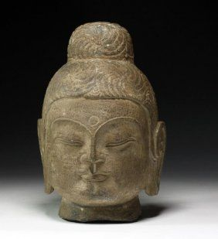
Buddhism and Daoism
1000+ years ago: Chinese Buddhism marked by mass devotion, high-level organisation and dominance (esp. Tang dynasty period of cultural tolerance)
Currently: Buddhism and Daoism officially recognised religions with legal status
Allowed to maintain temples; generally not thought to pose ‘threat’ to CCP, but…
Both compromised / co-opted by state to different degrees

Slide 5
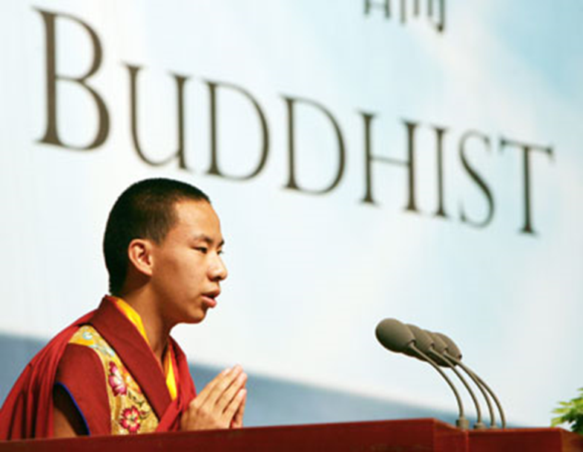
Buddhism and Daoism
Buddhists have allowed themselves to be used in state cultural propaganda
1st World Buddhist Forum, Hangzhou, 2006
Gyaltsen Norbu (16), China's
disputed choice for Tibet’s
Panchen Lama, delivered speech
Endorsed China’s policies on
religion; said Buddhists should be
patriotic and ‘defend the nation’
2009 speech: promised to ‘guide
Tibetan Buddhists to adapt to China’s
socialist society’; ‘cherish the bright future offered by CCP’

Slide 6
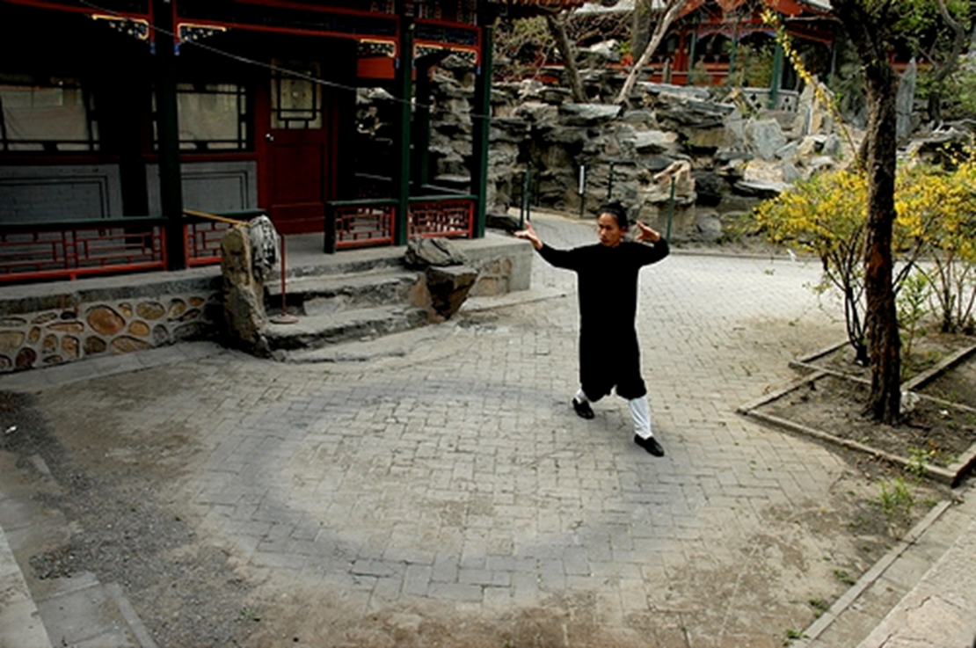
Daoism
Institutional Daoism less obviously compromised; Daoists maintain distance from the state

Slide 7
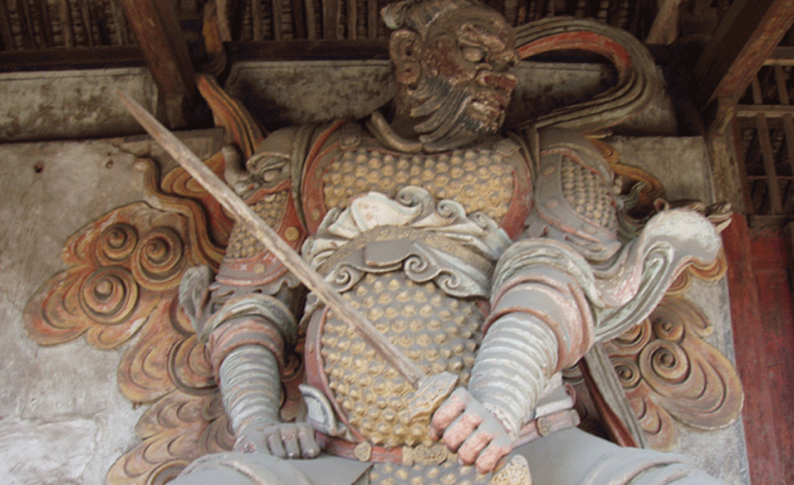
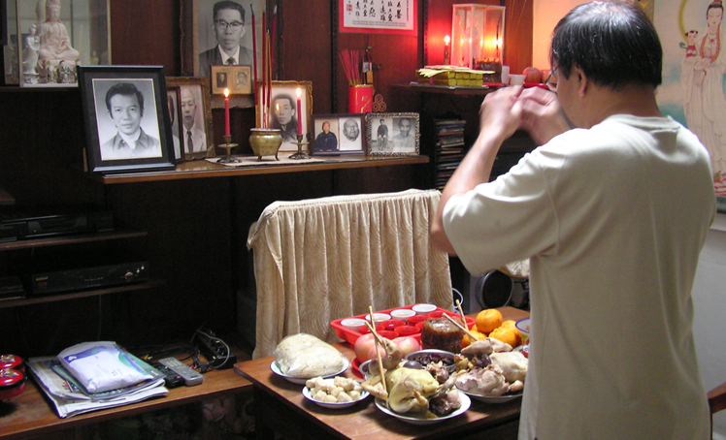
‘Folk’ or ‘Popular’ Religion
Ocean of popular, everyday religious beliefs among Han under umbrella of ‘folk religion’
Characterised by strong localism
Generally feature polytheism
Ghosts and spirits; senior
Buddhist / Daoist divinities;
apotheosised figures from
history; gods borrowed from
non-Han aboriginal peoples
Seen by political centre as potentially subversive for centuries
Suppressed in Imperial China and during the Maoist period

Slide 8
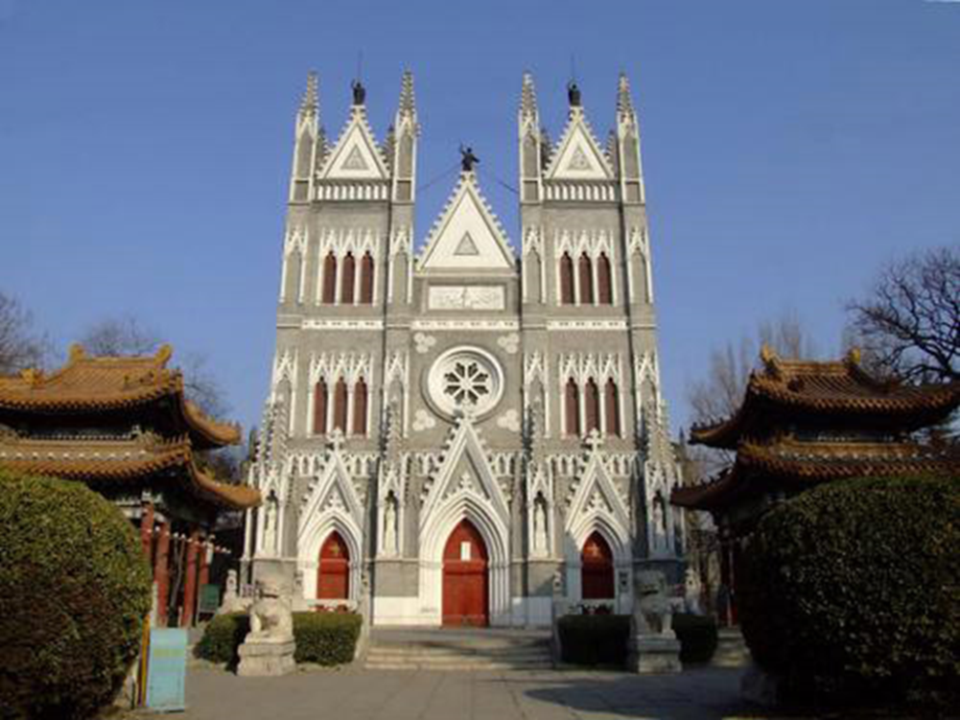
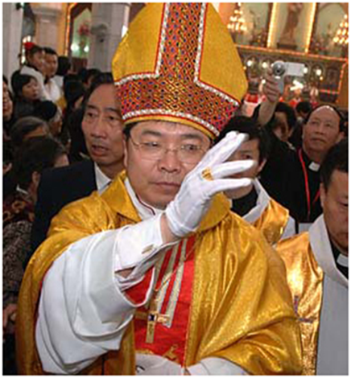
Chinese Christianity
Catholicism = official minority religion, imported from Latin Europe, 17c.
Anglo-American Protestantism imported in 19c.
The two have different Gods
Chinese Catholics worship Tianzhu 天主 [Lord of Heaven, Buddhist origin]
Chinese Protestants worship
Shangdi 上帝 [Supreme Ruler,
Chinese origin]
Both perceived to be compromised by foreign ties; e.g., Catholics ‘nationalised’, forced to break with Rome
→Protestant sects merged into single organisation
Xishiku Catholic church, Beijing

Slide 9
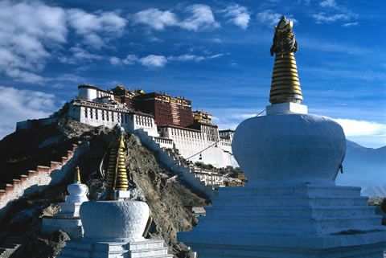
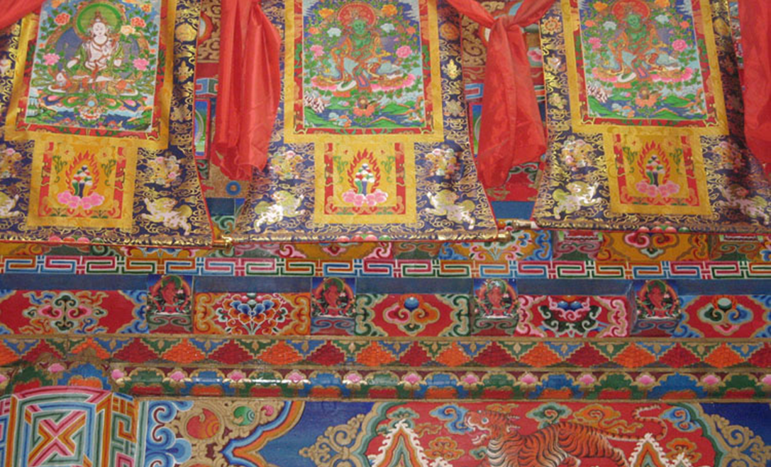
Religions among ethnic minorities: Buddhism
Buddhism, Islam and ‘folk’ / ‘popular’ religions most prominent
2 main forms of Buddhism
Tibetan Buddhism (Lamaism)
Theravada (Hinayana) Buddhism: e.g., Dai of Xishuangbanna in Yunnan, SW China
Mongolians converted to Tibetan
Buddhism early on, but religion
weak today among China’s
Inner Mongolians (result of 80%+
Han presence in region→ ‘dilution
effect’)

Slide 10
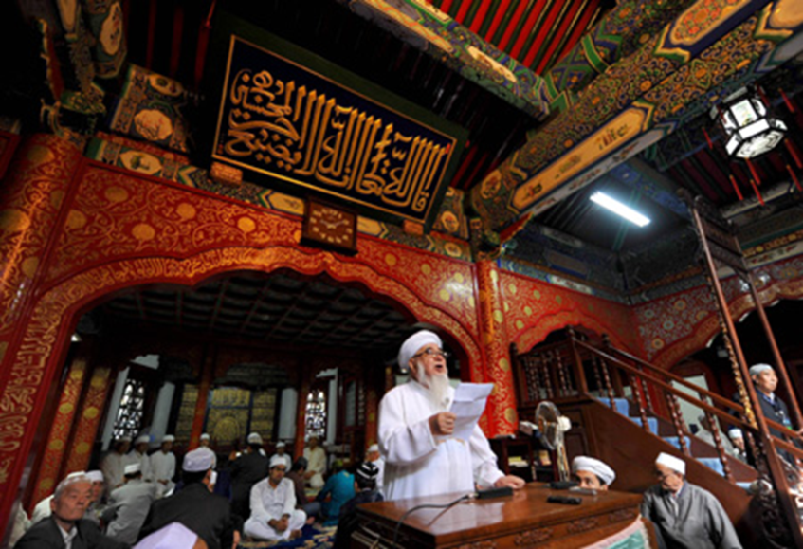
Religions among ethnic minorities: Islam
2000 PRC census: 18 million Muslims in China; other estimates claimed total of 30 million+
2010 PRC census: 23,308,000 Muslims
2020 PRC census: 26,000,000 Muslims
10 minority nationalities follow Islam; most Sunni
Niujie Mosque 牛街清真寺, Beijing, 2009

Slide 11
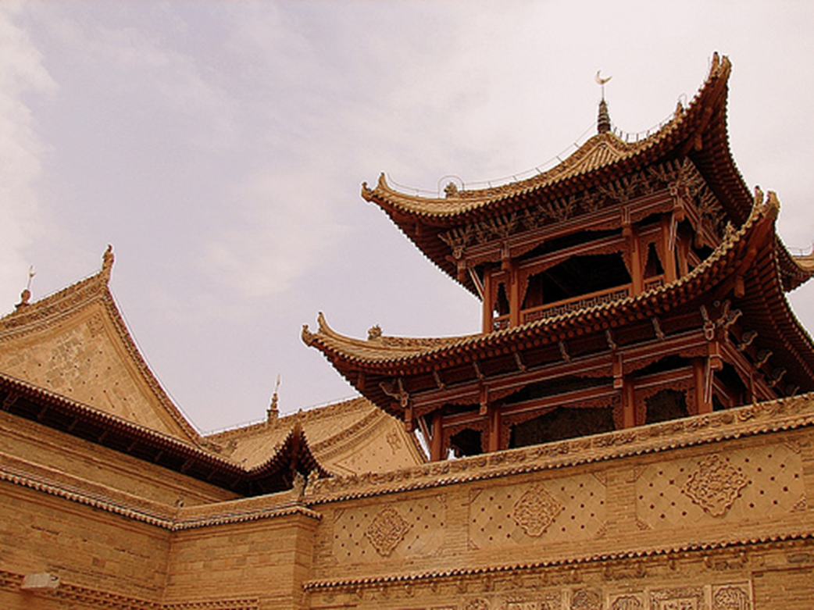
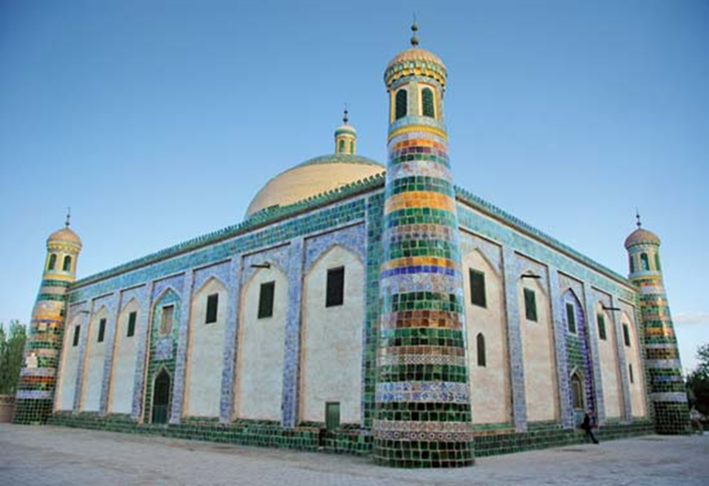
Religions among ethnic minorities: Islam
Largest Muslim groups =
Hui (descendants of Arab
traders and soldiers,
intermarried with Han)
Uyghurs (Turkic-Altaic origin)
Hui and Uyghurs pray in separate mosques
Great Mosque (Hui) of Tongxin, Ningxia 宁夏
Id-gah mosque, Kashgar, Xinjiang

Slide 12
‘Official’ (‘Normal’) vs. ‘Unofficial’ (‘Abnormal’) religion
China’s Constitution (1982):
Article 36: Citizens of the PRC enjoy freedom of religious belief. No state organ, public organisation or individual may compel citizens to believe in, or not to believe in, any religion; nor may they discriminate against citizens who believe in, or do not believe in, any religion. The state protects normal religious activities. No one may make use of religion to engage in activities that disrupt public order, impair the health of citizens or interfere with the educational system of the state. Religious bodies and religious affairs are not subject to any foreign domination.

Slide 13
‘Official’ (‘Normal’) vs. ‘Unofficial’ (‘Abnormal’) religion
‘Illegal’ (‘abnormal’) religious activities’ = any activity perceived to threaten CCP rule or PRC state security
Religious nationalism in Tibet / Xinjiang = ‘national splittism’
Characterised as ‘cynical use of religion’ as ‘pretext to destroy unity of [Chinese] motherland’
Popular protests in Tibet 2008 / Xinjiang 2009 against CCP policies painted as ‘violent separatism’
Heavy securitisation and religious repression in both regions
CCP claimed Uyghur protestors linked to al-Qaeda / international terrorism
Friday prayer, White Mosque, Ürümchi, post-July riots 2009

Slide 14
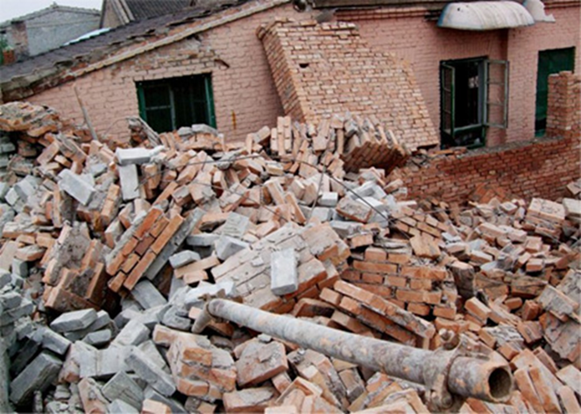
‘Official’ (‘Normal’) vs. ‘Unofficial’ (‘Abnormal’) religion
Chinese ‘house churches’
Sept 2009: 400 people in police clothes raided “Good News Cloth Shoes Factory” – a.k.a Fushan house church (80,000 members)
Mob bulldozed brick buildings; attacked church members with bricks; 100+ people injured
Unofficial ‘house church’

Slide 15
Cycles of religious repression and resurgence
Cultural Revolution (1966-76) characterised by religious persecution
Mao and Red Guards attempted to destroy religion as one of ‘Four Olds’ = superstitious, feudal practices including:
Old ideas
Old culture
Old customs
Old habits
Religious repression always followed by resurgence
1980 onwards→ conciliatory state policies towards religion
Collapse of Maoist ideology left vacuum of faith in Chinese society→ all religions benefited…

Slide 16
Cycles of religious repression and resurgence
In context of 1980s conciliatory policies:
Buddhist and Daoist shrines drew great numbers of worshippers, donors and new disciples
Corresponding revival of underground Roman Catholic Church
Rapid spread of private Protestant sects via unofficial ‘house churches’
Everyday ‘folk’ beliefs (believed to have disappeared under Maoism) re-emerged stronger than ever

Slide 17
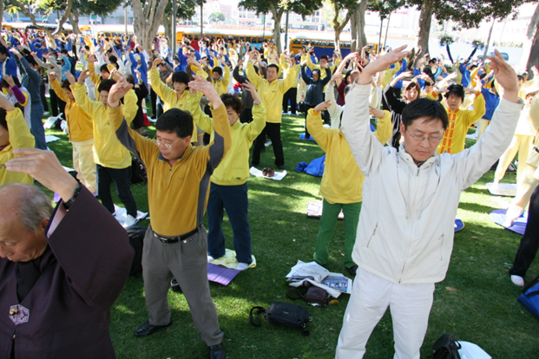
State fear of millenarian / sectarian risings
Tradition of risings in China by secret underground ‘cults’ (xiejiao 邪教)
Vision of world as ruled by ‘demonic’ forces; must be cleansed through violence
Often associated with martial arts / cultivation of mind and body
AD184 Yellow Turbans sect: used Daoist language, brought down Han dynasty
AD515 Mahayana Rebellion: used Buddhist slogans, led by monks
19c. White Lotus sect: used Buddhist language, membership grew amid social disorder
19c. Taiping Rebellion: took on Protestant concepts, saw Qing dynasty Manchus as ‘demons’
Turn of 20c. Boxer Rebellion: organised popular resistance against foreign Christian missionaries / Chinese converts to Christianity
Perceived contemporary threat of Falungong

Slide 18
Xi Jinping’s call to ‘Sinicise’ religion (2014→)
In Xi era, growing insecurity within Chinese Communist Party (CCP), faced with domestic and external challenges:
Social inequality / class unrest arising from economic transformation
Proliferation of non-governmental organizations, independent media and potentially destabilizing mass movements
Failure to reconstruct a persuasive state ideology
Loss of ideological orientation, growing corruption, and endemic legitimacy crisis within CCP
Intensifying ethnic tensions in Tibet and Xinjiang, which experienced riots in 2008 and 2009, respectively

Slide 19
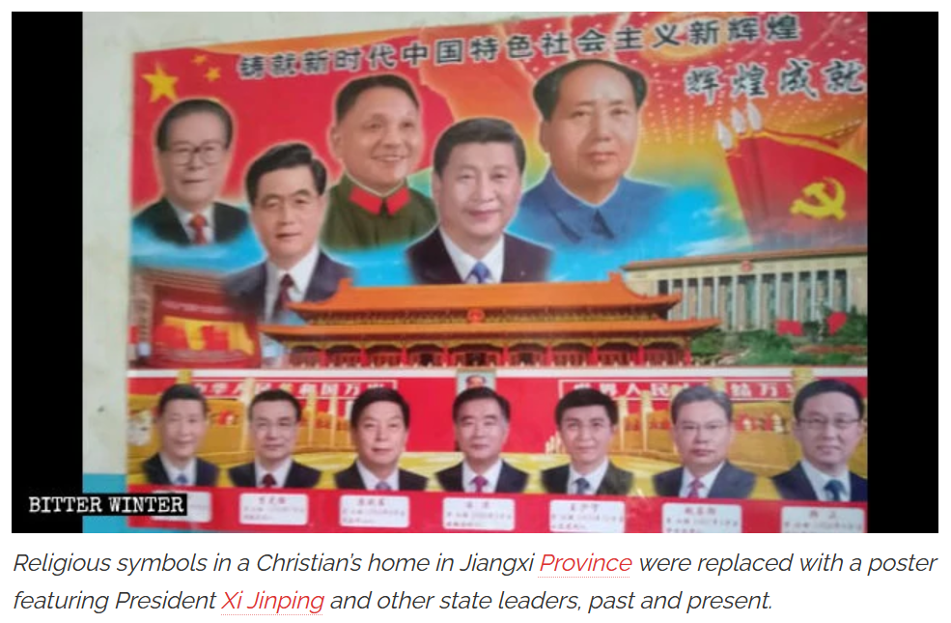
Xi Jinping’s call to ‘Sinicise’ religion (2014→)
Exhaustion of China’s export-led economic model (and potential erosion of CCP’s performance legitimacy)
China’s ongoing perception of Western-led plot to effect regime change in Beijing (Al-Sudairi 2017)

Slide 20
Xi’s call to ‘Sinicise’ religion (2014→)
2014 Kunming train station attack by Uyghur perpetrators: economic development replaced by ‘social stability’ (shehui wending) as second key policy frame alongside ‘permanent order’ (changzhijiu’an)
Xi placed renewed emphasis on ‘ideological work’, ‘ethnic unity work’ and the
‘suppression of the spread of extremist religious thinking’
2014 People’s War on Terror (in fact, a War on Islam)
2017 Regulation on De-extremification (qu jiduanhua): call for ‘Sinicization’ of religion
Adaptation of religion to socialist society to make believers aware of their role in serving state interests and supporting CCP leadership
The Party now sought to ‘solve the problem of to whom to listen, whom to trust, and whom to follow’ (Klimeš 2018): not God, but the CCP
https://www.chinalawtranslate.com/en/xinjiang-uyghur-autonomous-region-regulation-on-de-extremification/

Slide 21
‘De-extremification’ (qu jiduanhua) in Xinjiang
“Getting Rid of the ‘75 Expressions of Religious Extremism’”(Qu jiduanhua de 75 zhong biaoxian 去极端化的75种表现, 24 July 2017)
1. Promoting the future independence of Xinjiang.
2. Attacking current government policies and laws.
3. Ostracising “heathens” (non-believers).
4. Inciting “holy war” and terrorist violence.
5. Rejecting ‘patriotic religious personnel’ and refusing to pray in state-sanctioned mosques.
6. Debating with clerics how to teach the Quran during ordinary religious activities.
7. Distorting Xinjiang history.
8. Ostracising low-level officials as “heathens”.

Slide 22
‘De-extremification’ (qu jiduanhua) in Xinjiang
9. Growing long beards; wearing veils
10. Suddenly giving up drinking alcohol or smoking cigarettes.
11. Secretly funding and helping relatives of dangerous criminals apprehended by the state.
12. Encouraging marriage with a wife whose husband was sentenced to death.
13. Repressing the normal circulation of goods on the pretext that they are not halal.
14. Repressing modern and ethnic costume, music and dance on the pretext of purifying religion.
15. Repressing cultural activities like football games, singing competitions, etc.
16. Refuse to accept government management, e.g. damage or discard ID cards, wedding certificates, etc.
17. Not allowing women to go out to work, making them wear restrictive clothing.
18. Not allowing children to study Chinese.
19. Dropping out of school to study the Quran.
20. Closing restaurants during Ramadan; making waiting staff wear the jilbab. […]

Slide 23
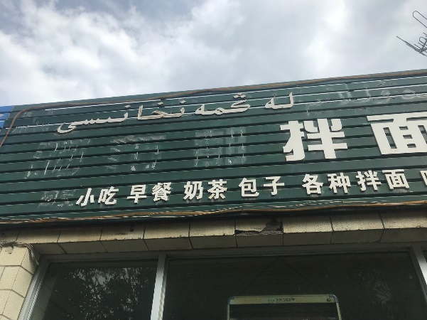
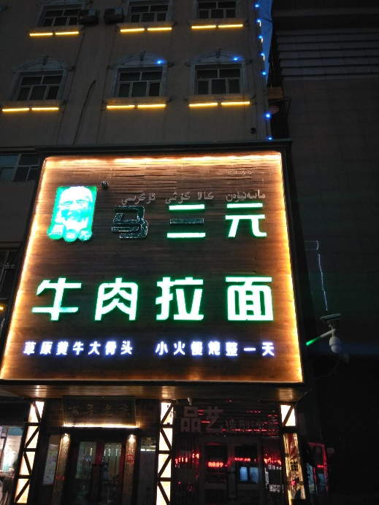
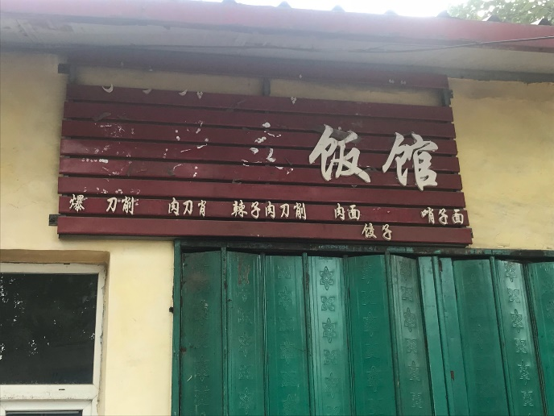
Violation of halal business spaces Removal of Halal signage: restaurants in Urumchi, Kashgar, Ghulja, 2018

Slide 24
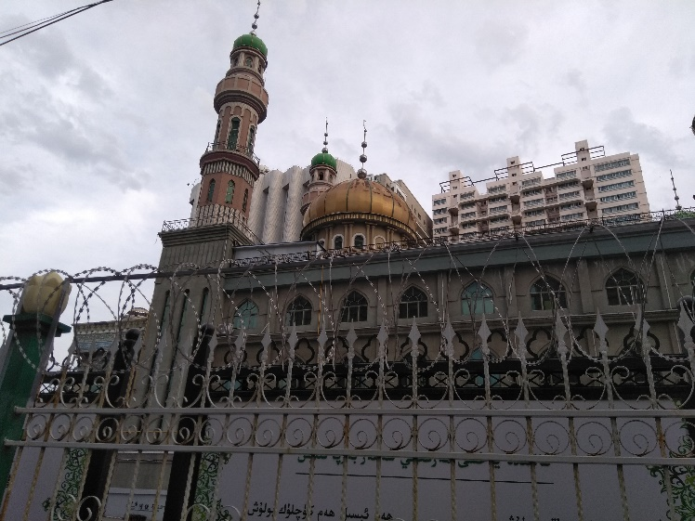
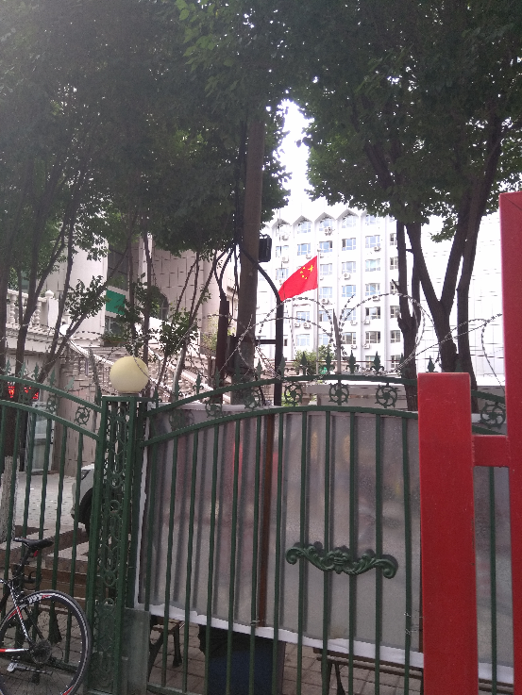
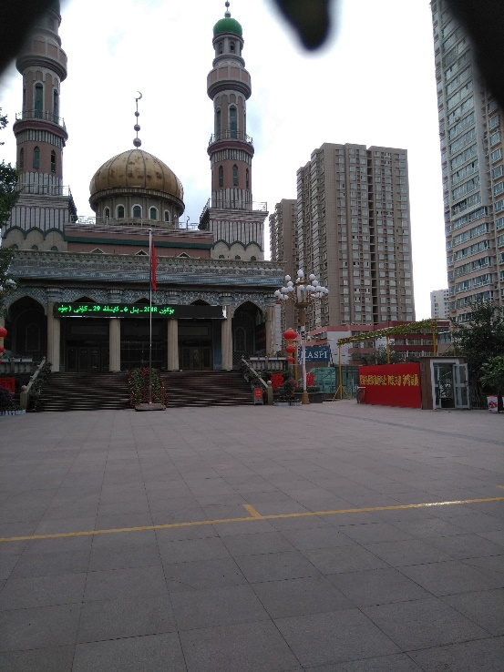
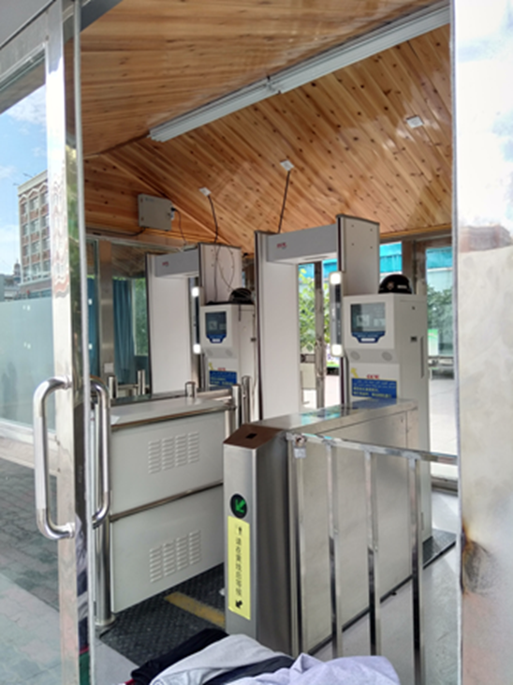
Violation of mosque spaces Urumchi, 2018

Slide 25
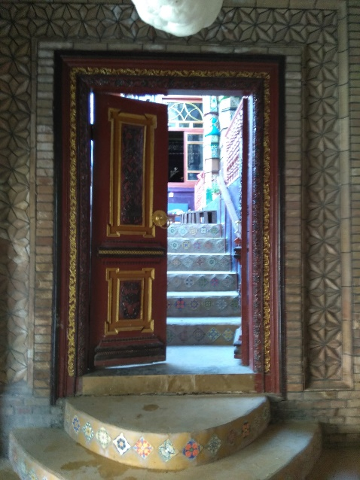
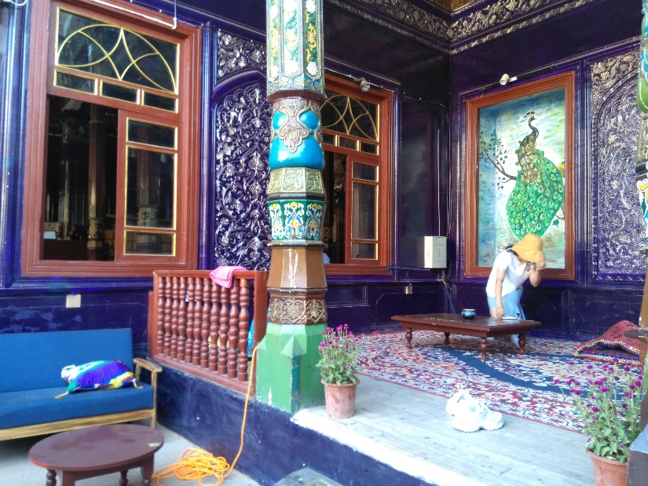
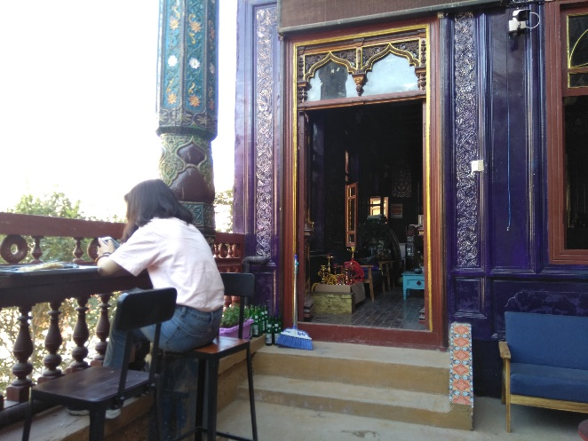
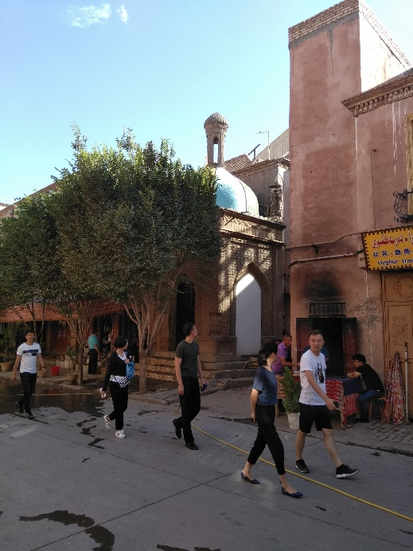
The Dream of Kashgar Once a mosque… now a café-bar, Kashgar, 2018

Slide 26
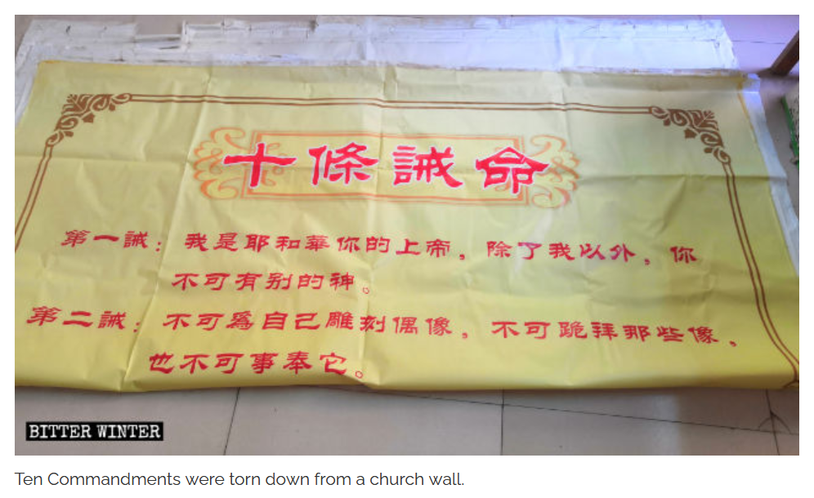
‘Sinicisation’ policy spreading throughout China
Replacement in 2018-19 in many Christian venues of the Ten Commandments with the sayings of Xi Jinping
As one Chinese preacher put it: ‘The Communist Party’s ultimate goal is to “become God”’ (Bitter Winter, 2019)
People prohibited from dancing/exercising to Buddhist music in public squares, as lyrics contain religious terms…

Slide 27
‘Sinicisation’ policy spreading throughout China
“A local Buddhist commented that Buddhist songs are not allowed in public spaces because the government fears that if people listen to religious music, they will start believing in Buddhism, undermining the government’s rule and authority” (Bitter Winter, 2019)
Reflects not genuine fear of “religious extremism” but state paranoia and regime insecurity

Slide 28
‘Sinicisation’ policy spreading throughout China
Recently, PRC revised and tightened religious regulations:
2018 Religious Affairs Regulations
https://english.www.gov.cn/policies/latest_releases/2017/09/07/content_281475842719170.htm
2020 Administrative Measures for Religious Groups
https://www.chinalawtranslate.com/en/measures-for-the-administration-of-religious-groups/
2023 Adminisrative Measures for Religious Activity Venues
https://www.chinasource.org/resource-library/blog-entries/the-2023-regulations-for-religious-activity-site-registration/
2024 Xinjiang Uyghur Autonomous Region Religious Affairs Regulations
https://www.chinalawtranslate.com/en/xj-religious-affairs/

