Slide 1
Gore Alternative Fees (AFAs)
Trademark Fee Structure Stages
Entering
Updating
Submitting Invoices with Alternative Fee Structures

Slide 2

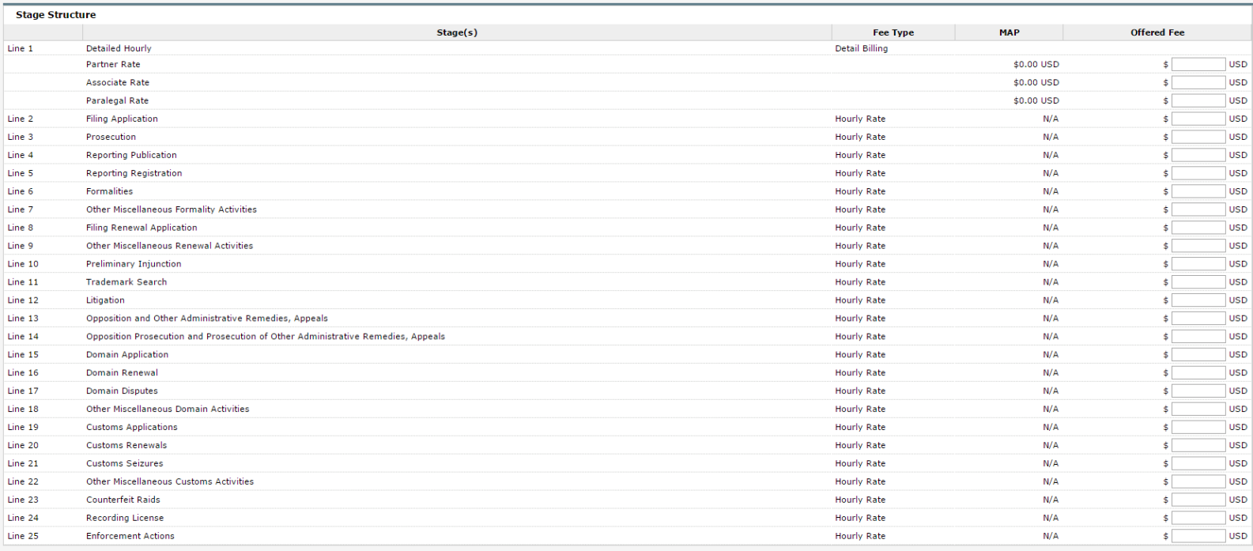
Gore Trademark Fee Structure Stages
Gore Task Based Trademark Fee Structure:
Gore has put together a collection of rate structure stages that allow for flexibility with submitting invoices for trademark matters. To the left is a sample of some of the stage lines which are available to which offers may be submitted. A full list is available at the end of this document.
Considerations when submitting fee offers
Expenses are not included in the fee offer and can be billed on any stage.
Charges submitted and not associated with a stage will default to stage 1 (Detailed Hourly)
Subsequent fee offers will not update existing matters. Gore will need to take action if edited fees are to be applied to existing matters.
Fee Types
Detail Billing | Any detailed hourly work performed using timekeeper rates.
Flat Rate | Flat rate billing is allowed only once per matter for the exact amount submitted in the fee offer. Any duplicate submission will trigger invoice rejection.
Hourly Rate | Repeatable flat fee/Hourly rate. Allowed multiple times per matter for up to the amount submitted in the fee offer. Incorrect rates will trigger invoice rejection.
Please refer to the full list of stages and descriptions on the following pages as a guide for selecting the proper stage when submitting offers and invoices.

Slide 3
Gore Trademark Fee Structure Stages (cont.)
Stage # | Flat Fee Name | Service Description
Stage 1 | Detailed Hourly | Partner Associate Paralegal
Stage 2 | Filing Application | Preparing and filing a trademark, design or any other IP right application
Stage 3 | Prosecution | Reporting of the examination of application; Provide recommendation and opinion on how to proceed; Filing of various actions such as Extension of Time, Amendments, Appeal or Cancellation Action, Response to an Opposition
Stage 4 | Reporting Publication | Reporting allowance of trademark or registration of trademark, design or other IP right
Stage 5 | Reporting Registration | Review and reporting registration; Arrangment/Providing trademark registration certificate
Stage 6 | Formalities | Filing of documents such as Assignments, Declarations, Power of Attorney; Correcting filing records or a change of ownership and/or address, etc.; Other miscellaneous fees after filing of application or registration.
Stage 7 | Other Miscellaneous Formality Activities | Miscellaneous activities or fees related to Formalities work not already listed above
Stage 8 | Filing Renewal Application | Notification of renewals, preparing and filing a trademark, design renewal or any other IP right renewal application
Stage 9 | Other Miscellaneous Renewal Activities | Miscellaneous activities or fees related to Renewal work not already listed above
Stage 10 | Preliminary Injunction | Preparation and obtaining Preliminary Injunction
Stage 11 | Trademark Search | Performing a prior trademark or design search
Stage 12 | Litigation | Filing of initial lawsuit or responding to a lawsuit
Stage 13 | Opposition and Other Administrative Remedies, Appeals | Filing of an opposition and other administrative remedies, appeals
Stage 14 | Opposition Prosecution and Prosecution of Other Administrative Remedies, Appeals | Work related to the opposition prosecution, etc. (Defending an Opposition filed against Client's case.)

Slide 4
Gore Trademark Fee Structure Stages (cont.)
Stage # | Flat Fee Name | Service Description
Stage 15 | Domain Application | Filing of a Domain registration
Stage 16 | Domain Renewal | Filing of a Domain renewal
Stage 17 | Domain Disputes | Work related to the cancellation and transfer of ownership of a Domain
Stage 18 | Other Miscellaneous Domain Activities | Miscellaneous activities or fees related to Domain work not already listed above
Stage 19 | Customs Applications | Filling of a Customs Application
Stage 20 | Customs Renewals | Filling of a Customs Renewal
Stage 21 | Customs Seizures | Cost for the seizing and detainment of counterfeits goods
Stage 22 | Other Miscellaneous Customs Activities | Miscellaneous activities or fees related to Customs work not already listed above
Stage 23 | Counterfeit Raids | Costs related to conducting a raid
Stage 24 | Recording License | Recording a licence at the TMO, attending to payment of the appropriate fee, and updating agent records accordingly
Stage 25 | Enforcement Actions | Preparing and sending of C&D letters for Infringements including Counterfeits and Unfair Competition matters, Enforcement Disputes and related costs, settlements or responding to C&D letters, Cost of Investigations and potential notarized purchases, etc.

Slide 5
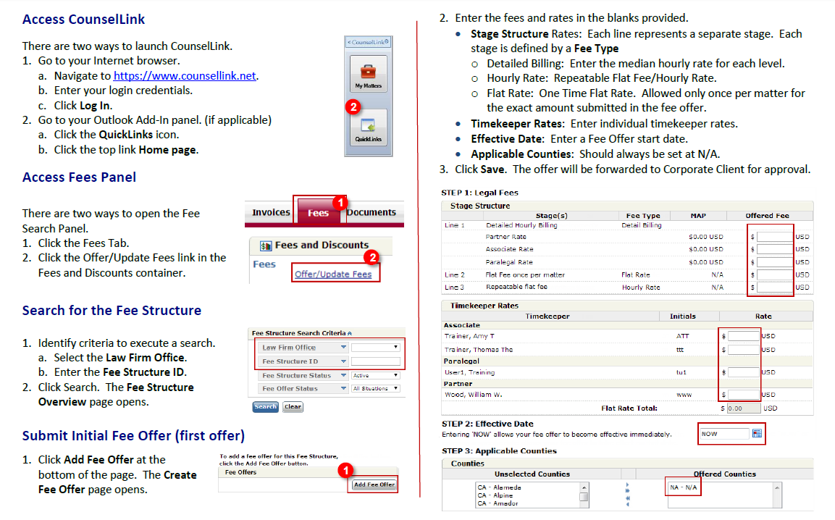
Trademark Fee Structure - Offering Fees

Slide 6
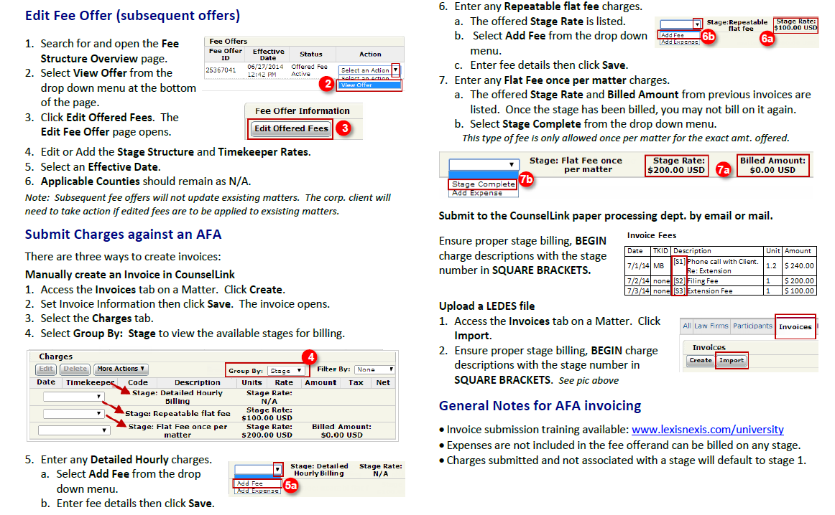
Trademark Fee Structure – Editing Offer and Invoicing

