Slide 1
WL Gore Alternative Fees (AFAs)
Patent Fee Structure Stages
Entering
Updating
Submitting Invoices with Alternative Fee Structures

Slide 2
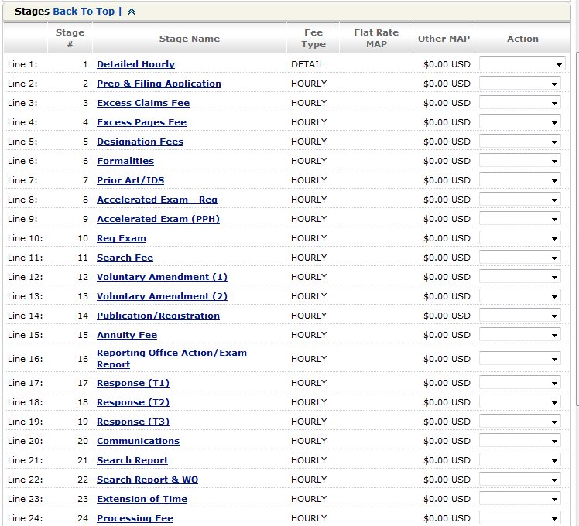
WL Gore Patent Fee Structure Stages
WL Gore Task Based Patent Fee Structure: 5748
WL Gore has put together a collection of rate structure stages that allow for flexibility with submitting invoices for patent matters. To the left is a sample of some of the stage lines which are available to which offers may be submitted. A full list is available at the end of this document.
Considerations when submitting fee offers
Expenses are not included in the fee offer and can be billed on any stage.
Charges submitted and not associated with a stage will default to stage 1 (Detailed Hourly)
Subsequent fee offers will not update existing matters. WL Gore will need to take action if edited fees are to be applied to existing matters.
Fee Types
Detail Billing | Any detailed hourly work performed using timekeeper rates.
Flat Rate | Flat rate billing is allowed only once per matter for the exact amount submitted in the fee offer. Any duplicate submission will trigger invoice rejection.
Hourly Rate | Repeatable flat fee/Hourly rate. Allowed multiple times per matter for up to the amount submitted in the fee offer. Incorrect rates will trigger invoice rejection.
Please refer to the full list of stages and descriptions on the following pages as a guide for selecting the proper stage when submitting offers and invoices.

Slide 3
WL Gore Patent Fee Structure Stages (cont.)
Stage # | Flat Fee Name | Service Description
Line 1: | Detailed Hourly | Partner Associate Paralegal
Line 2: | Prep & Filing Application | Preparing and filing a patent application (including but not limited to divisional design, PCT applications, etc.), including entering the application details onto agent records, monitoring safe receipt of the application, and reporting official filing details to client
Line 3: | Excess Claims Fee | Attending to the payment of excess claims fees and updating agent records accordingly
Line 4: | Excess Pages Fee | Excess Pages (Pages in excess of the PTO limit; per page)
Line 5: | Designation Fees | Payment of designation fees and updating records accordingly
Line 6: | Formalities | Assignments, Declarations, Legal Rep Declarations. Correcting filing records or a change of ownership and/or address, inventorship, etc. Filing priority documents. Filing inventor details. Updating agent record accordingly. Miscellaneous fees after filing of application, but before examination begins.
Line 7: | Prior Art/IDS | Filing prior art, relevant art, search reports
Line 8: | Accelerated Exam - Reg | Filing Request for Accelerated Examination
Line 9: | Accelerated Exam (PPH) | Filing Request for Accelerated Examination under patent prosecution Highway (PPH) including Voluntary Amendment to amend claims to correspond with allowed claims.
Line 10: | Req Exam | Preparing and filing a request for examination. Payment of the PTO fee for examination.
Line 11: | Search Fee | Preparing and filing a request for a search and payment of the PTO search fee
Line 12: | Voluntary Amendment (1) | Filing Voluntary Amendment (where client provides complete claim set for filing)
Line 13: | Voluntary Amendment (2) | Filing Voluntary Amendment (where agent prepares amended claims for VA)
Line 14: | Publication/Registration | Notice of Publication and due date to register in Hong Kong.
Line 15: | Annuity Fee | Attending to the "Xth" year annuity for parent and sibling cases including any divisional applications

Slide 4
WL Gore Patent Fee Structure Stages (cont.)
Stage # | Flat Fee Name | Service Description
Line 16: | Reporting Office Action/Exam Report | Reporting (Non-Final or Final) Office Action (no charge for reminders of approaching due date); or Receiving an examination report, entering the due date for responding to the examination report onto agent records, and reporting the examination report to client.
Line 17: | Response (T1) | Preparing and filing a Response - Tier 1 - Response instructions provided by client. Agent will review and make minor formality amendments to claims and response to ensure in compliance with PTO practice. Agent will file the response and report to client.
Line 18: | Response (T2) | Preparing and filing a Response - Tier 2 - Full response instructions provided by client. Agent will prepare response including arguments without reviewing prior art, amending claims and disclosure and filing response.
Line 19: | Response (T3) | Preparing and filing a Response - Tier 3 - At request of client, agent will provide draft response, guidance for responding to objections. Reviewing cited prior art, and/or prosecution history of corresponding application, amending claims and disclosure, preparing response with arguments and filing response.
Line 20: | Communications | Receiving a communication from the PTO setting a deadline for client to respond, up-dating records to monitor the deadline for reply and reporting to client. Reply to PTO.
Line 21: | Search Report | Receiving a search report, entering the search report onto our records, and reporting to client
Line 22: | Search Report & WO | Receiving a search report and written opinion from the PTO examiner, entering the search report onto agent records, and reporting to client
Line 23: | Extension of Time | Requesting an extension of time or term extension
Line 24: | Processing Fee | Payment of the fee for further processing of the application
Line 25: | Summons To Oral Proceedings | Receiving a summons to oral proceedings, entering the due date for responding to the summons on agent records, and reporting to client
Line 26: | Limitation of Claims | Filing a request for limitation of claims at the PTO, and updating agent records accordingly
Line 27: | Re-Establishment/Reinstatement | Filing a request for re-establishment ( including maintain abandoned application or reinstatement, request for further proceedings) at the PTO, and updating agent records accordingly.
Line 28: | Miscellaneous Pros | Miscellaneous fees for prosecution not covered above

Slide 5
WL Gore Patent Fee Structure Stages (cont.)
Stage # | Flat Fee Name | Service Description
Line 29: | Appeal Fee | Filing an appeal, payment of the appeal fee, and updating agent records accordingly
Line 30: | Appeal Prosecution | Work related to the appeal prosecution, etc.
Line 31: | Notice of Grant | Processing Notice of Allowance (Payment of Final Fee) or Notification of Grant, translation of claims and fees, the Grant document, and reporting to client
Line 32: | Reporting Completion | Noting completion of the required action and updating agent records accordingly
Line 33: | National Validation (1) | Attending to National Validation of the Patent and registering agent as Address for Service
Line 34: | National Validation (2) | Attending to National Validation of the Patent including obtaining & submitting Translations of the Claims, and registering agent as Address for Service
Line 35: | National Validation (3) | Attending to National Validation of the Patent including obtaining and submitting a full translation, and registering agent as Address for Service
Line 36: | Miscellaneous Grant | Miscellaneous fees for grant not covered above.
Line 37: | Opposition Fee | Filing an opposition, payment of the opposition fee, and updating agent records accordingly (Defending an Opposition filed against Client's case.)
Line 38: | Opposition Prosecution | Miscellaneous fees for grant not covered above.
Line 39: | Recording License | Recording a licence at the PTO, attending to payment of the appropriate fee, and updating agent records accordingly
Line 40: | Cancelling License | Cancelling a licence at the PTO, attending to payment of the appropriate fee, and updating agent records accordingly
Line 41: | Recording Security | Recording a security interest at the PTO, attending to payment of the appropriate fee, and updating agent records accordingly

Slide 6
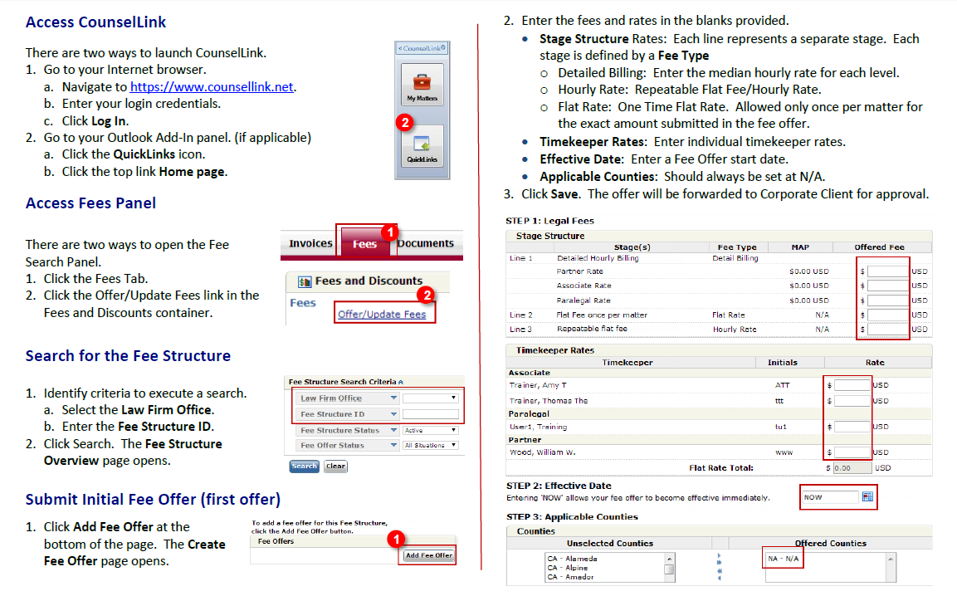
Patent Fee Structure - Offering Fees

Slide 7
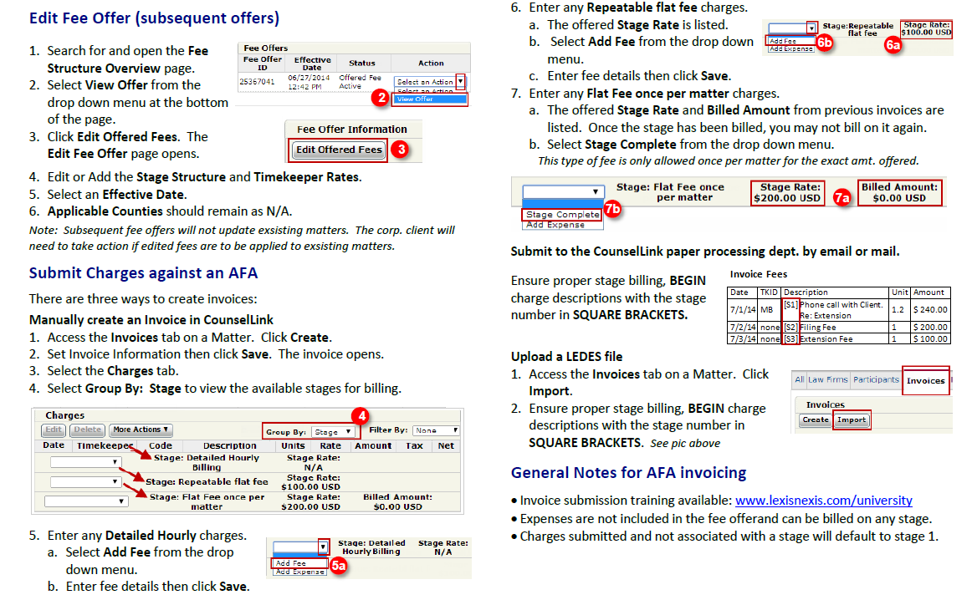
Patent Fee Structure – Editing Offer and Invoicing

