Slide 1
DICOM Imaging User Guide
Powerful Solutions, Effective Results

Slide 2
ADD DICOM IMAGING TO A NEW ORDER
To add a DICOM Imaging request to a new order, simply go the DICOM Imaging Section of the order form.
Check the DICOM Imaging box.

Slide 3
ADD DICOM IMAGING TO AN EXISTING ORDER
To add a DICOM Imaging request to an existing order, simply use the Add-on (+) feature at the case level of your Order Tracking screen.

Slide 4
ADD DICOM IMAGING TO AN EXISTING ORDER
To ensure DICOM notifications get sent to the correct individual in your office, the Contacts section will need to be updated. Enter the Contact Type, Name, Email, and check the necessary Emails to Receive options (shown below). Select the green plus sign to save the Contact. Use the below for reference:

Slide 5
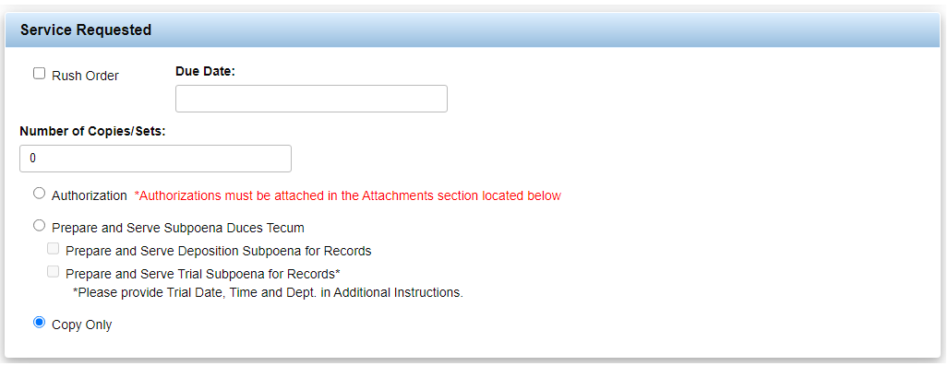
ADD DICOM IMAGING TO AN EXISTING ORDER
Go to the Service Requested section of the order form. Check the Copy Only option.

Slide 6
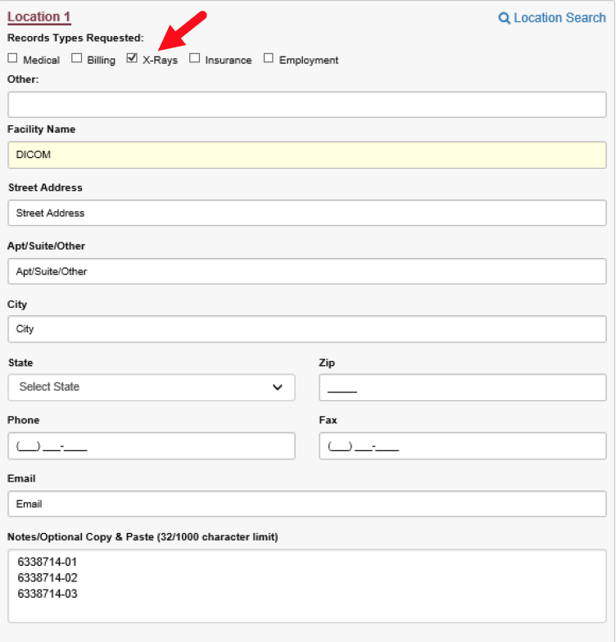
ADD DICOM IMAGING TO AN EXISTING ORDER
Go to the DICOM Imaging section of the order form. Check the DICOM Imaging box.
In the Locations section of the order form, populate DICOM in the Facility Name on Location 1.
Select the ‘X-Rays’ checkbox in the Records Types Requested section.
Use the Notes/Optional Copy & Paste section to indicate which facilities need DICOM Imaging. Use the following naming convention or “All” for all facilities: Work Order # -Facility #

Slide 7
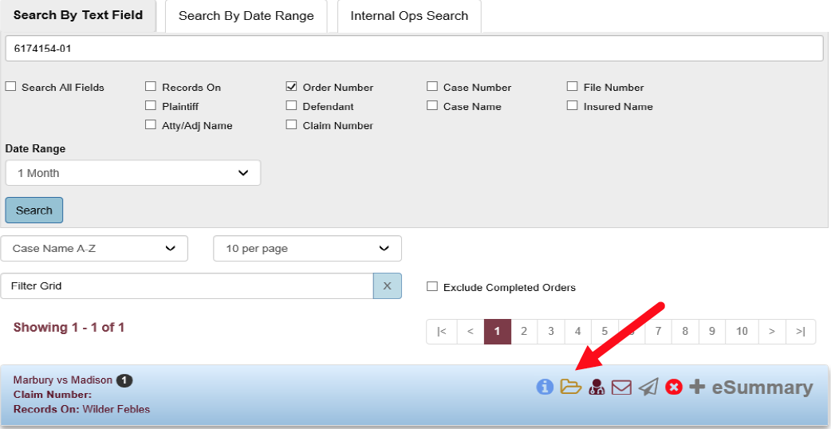
ACCESSING DICOM IMAGES THROUGH ABI WEB
From ABI Web Order Tracking, simply locate the desired order that included a DICOM diagnostic imaging study.
Open the Case Documents through the folder icon.
The DICOM images will be listed as Diagnostic Imaging under the File Type column.

Slide 8
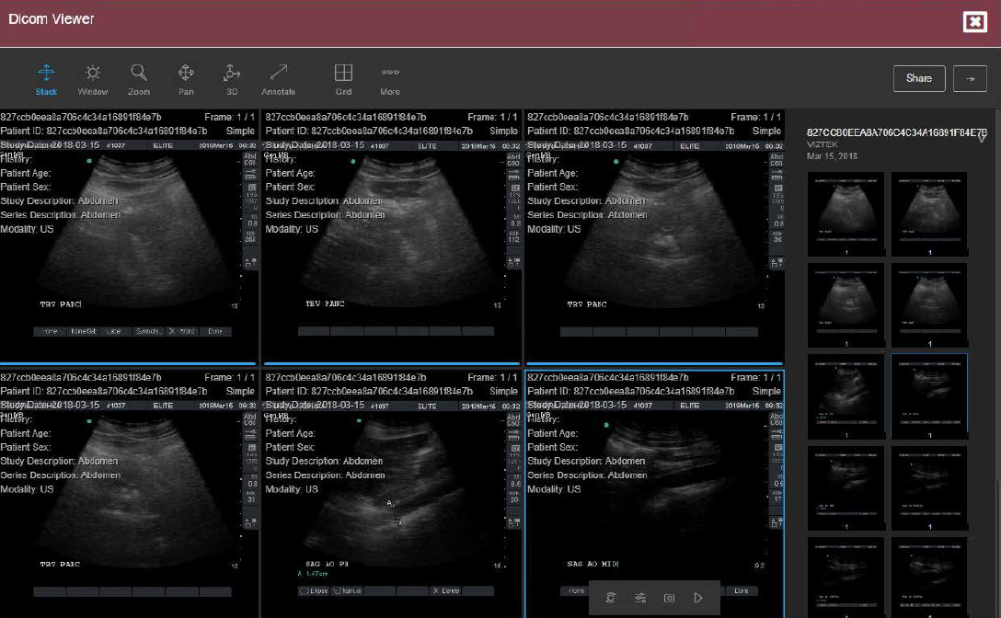
VIEWING IMAGES THROUGH DICOM VIEWER
Under the Action Column, click the DICOM Viewer Button to launch Box DICOM Viewer.
The Box DICOM Viewer allows Users to view and interact with the DICOM study.
Please Note: Users cannot use the Share feature included in the DICOM Viewer while in ABI Web. The Share feature is only enabled in the DICOM Viewer when logged in using a Box account.

Slide 9
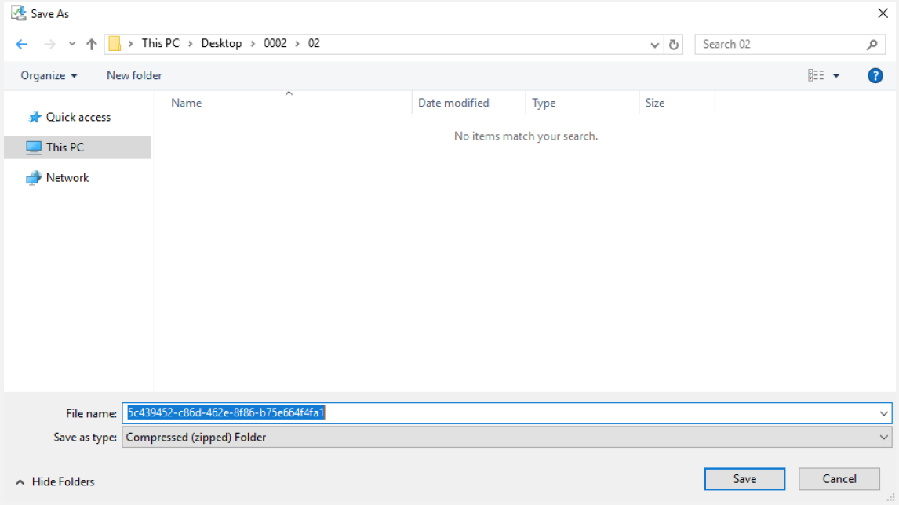
DOWNLOADING DICOM IMAGES
Under the Action Column, click the Download Button to download the DICOM Study.
Upon clicking the Download Button, a prompt for the download path and a confirmation to save the files will appear.
Please Note: Once downloaded, the DICOM files will be in a raw format without integrated functionality. Users will be required to open these files using a third party DICOM Viewer that has been installed directly on the PC.

Slide 10
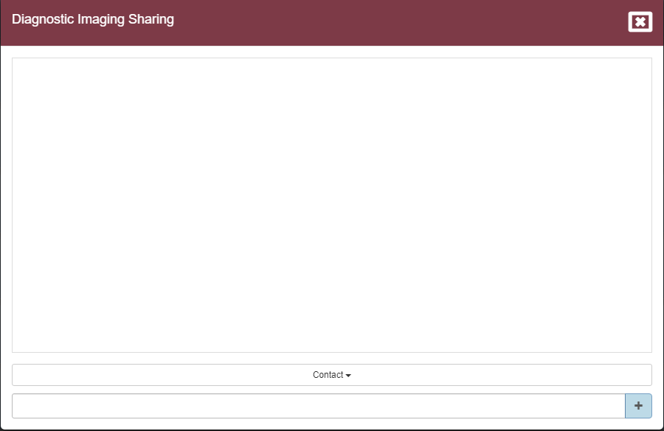
DICOM COLLABORATION
SHARING A SINGLE DIAGNOSTIC IMAGE
The Collaborator Button permits sharing diagnostic images directly from a work order on the document view.
Upon clicking the Collaborator Button in the Action Column, the Diagnostic Imaging Sharing window will appear. This modal is intentionally blank to allow space to add in email addresses for sharing.

Slide 11
DICOM COLLABORATION
SHARING MULTIPLE DIAGNOSTIC IMAGES
You can share multiple Diagnostic Images by going to Case Documents.
Select the images you’d like to share by using the checkboxes on the left.
Select the Collaborator Button at the top and follow the steps in Slide 12. This modal is intentionally blank to allow space to add in email addresses for sharing.

Slide 12
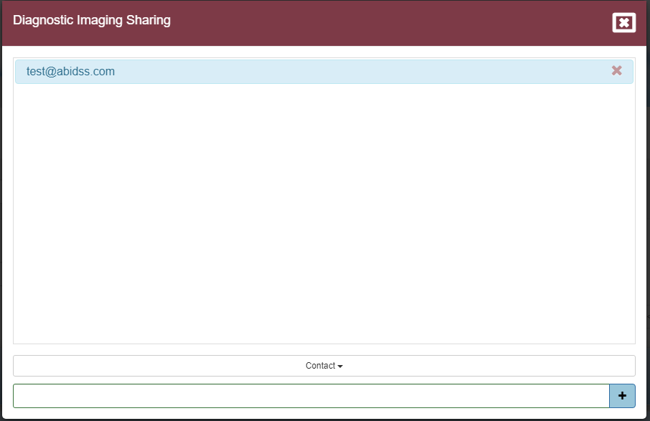
DICOM COLLABORATION
From here, you can utilize the Contact drop-down to select an email from the saved email address(es) added to your account.
If the email is not listed, you can simply type in the email address you’d like to send it to.
Then click the “+” Button to add the email address.
If the email address needs to be removed, click the red “x” next to the email address.
Users may repeat this process to share with multiple recipients. When complete, click the “X” Button at the top right corner to exit the window.
4
5
1
2
3

Slide 13
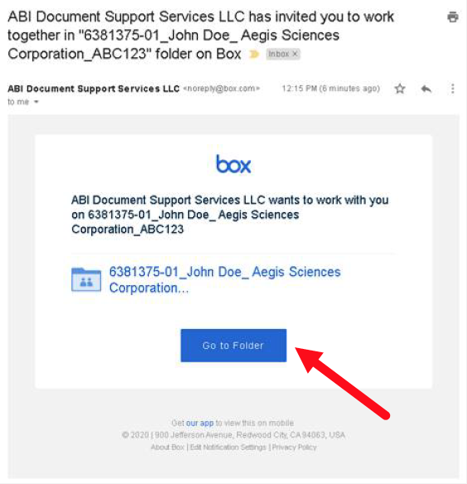
DOWNLOADING DICOM IMAGES
The recipient will receive an email where they can either click on the Collaborated Folder link or click on the Accept Invite Button to access the shared Diagnostic images. The naming convention for the folder is as follows: WO#_patient_facility_claim#.
Please Note: This link will only be valid for the intended party. Forwarding the link will result in no functionality.

Slide 14
Powerful Solutions,
Effective Results

