Slide 1


Shared Documents User Guide
Powerful Solutions, Effective Results

Slide 2

WHAT IS SHARED DOCUMENTS?
Shared Documents is a powerful tool that ABI clients can use to collaborate with adjusters, experts, attorneys and other stakeholders. Using this resource to securely share records and summary reports creates greater efficiency with more successful outcomes
Enhance communication by sharing documents and record summaries securely over an encrypted system to third parties, adjusters, experts, attorneys and other stakeholders
Save time and eliminate hours spent printing
Save money by eliminating paper and shipping costs
Easily navigate between documents

Slide 3

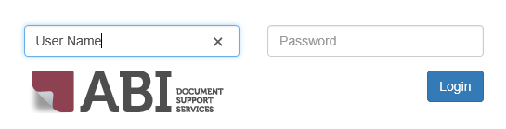
Shared Documents User Guide
LOGIN TO ABI WEBSITE
Go to ABI website at www.abidss.com. Select Login at top corner and enter the assigned User Name and Password into the designated boxes.

Slide 4
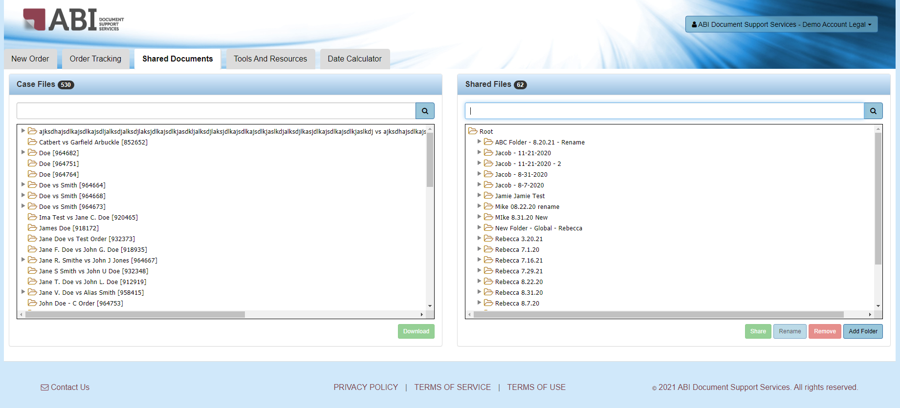
Shared Documents User Guide
HOW TO SHARE DOCUMENTS
SUB-ACCOUNT VIEW
Click on the Shared Documents tab, then locate a case by typing part of the name into the blank search box under the “Case Files” tab
After the case has been located, click on Add Folder in the right viewing pane under the “Shared Files” tab, and name the folder

Slide 5
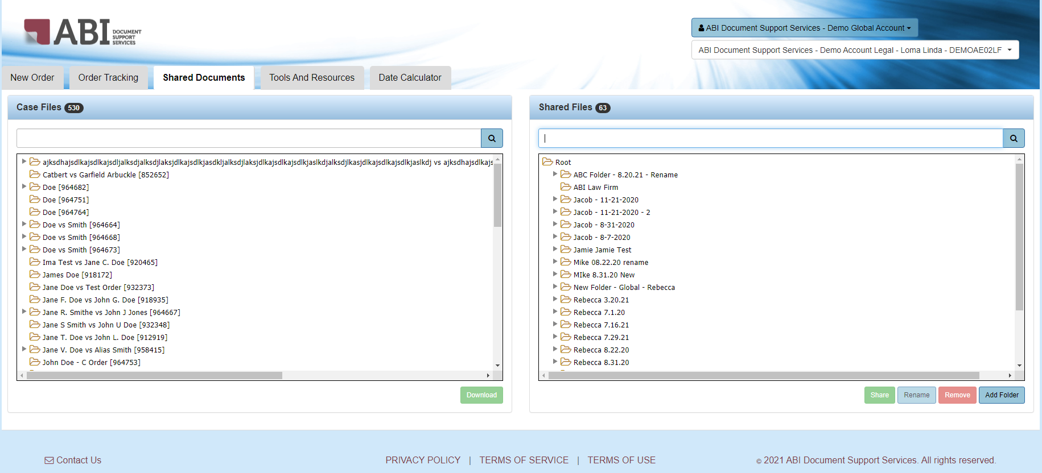
Shared Documents User Guide
HOW TO SHARE DOCUMENTS
GLOBAL ACCOUNT VIEW
Select a sub-account from the drop-down menu located at the upper right-hand side of the page. Click on the Shared Documents tab, then locate a case by typing part of the name into the blank search box under the “Case Files” tab
After the case has been located, click on Add Folder in the right viewing pane under the “Shared Files” tab, and name the folder

Slide 6
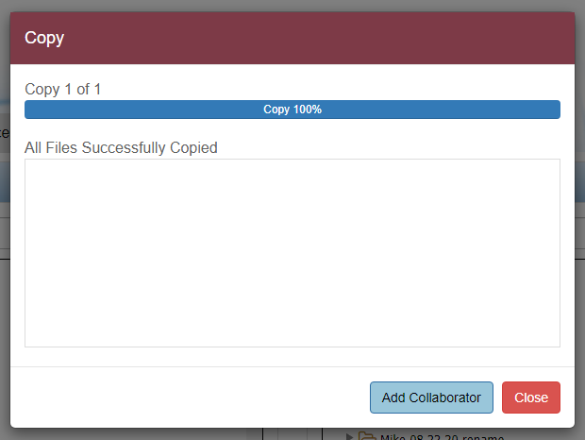
Shared Documents User Guide
HOW TO SHARE DOCUMENTS
Once a document is dragged to the newly added folder, a pop-up will appear indicating if the files successfully copied over. If the file(s) failed, the file name(s) will be listed
Here, you can select Add Collaborator to share the file (additional information found on page 8) or Close the ‘Copy’ pop-up

Slide 7
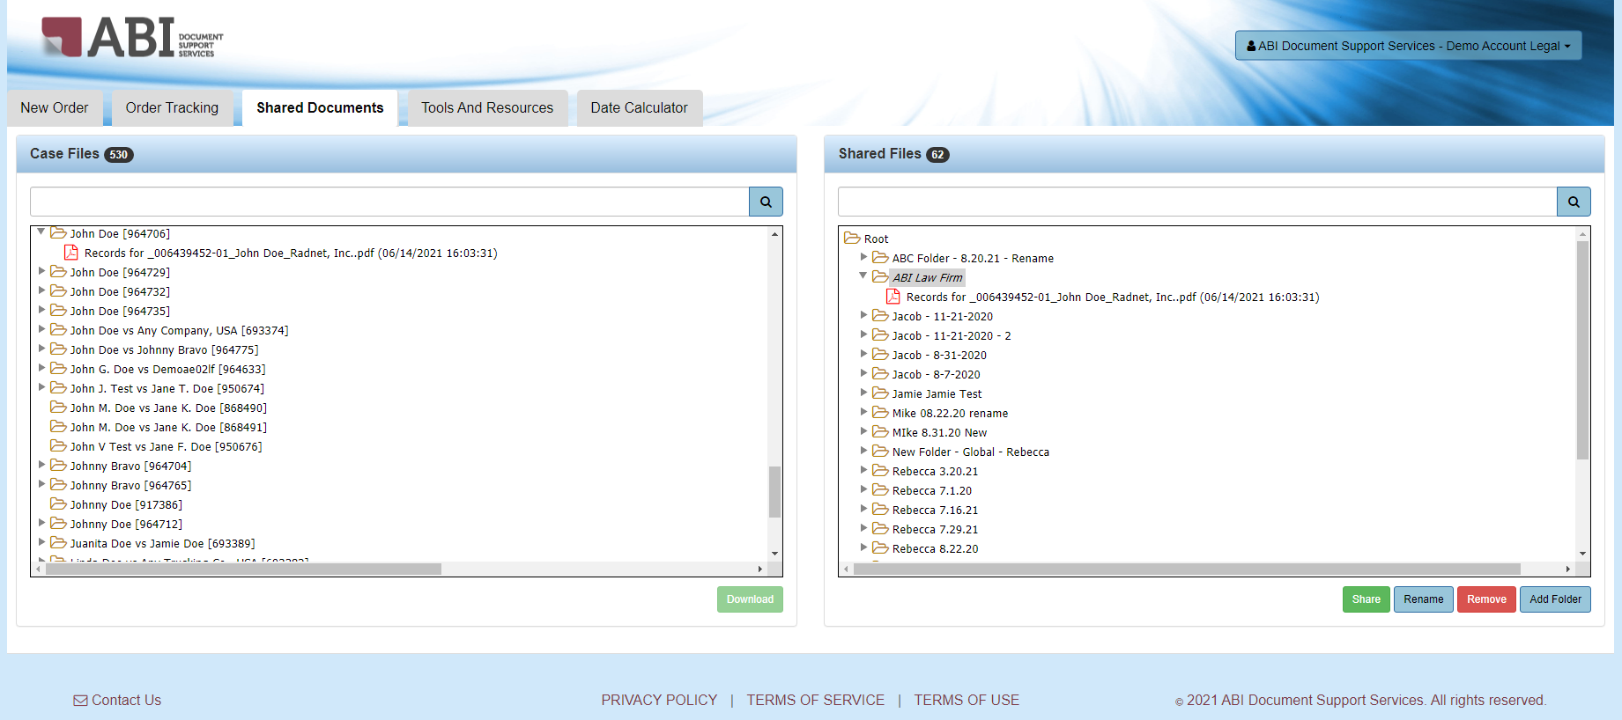
Shared Documents User Guide
HOW TO SHARE DOCUMENTS
Click on the newly created folder, then click the Share icon
Select the Rename icon at any time to change the name of your folder(s) or file(s)
Note: If you select the Remove icon after sharing documents with a collaborator, those documents will no longer be visible within the recipient’s eSummary Mobile account

Slide 8
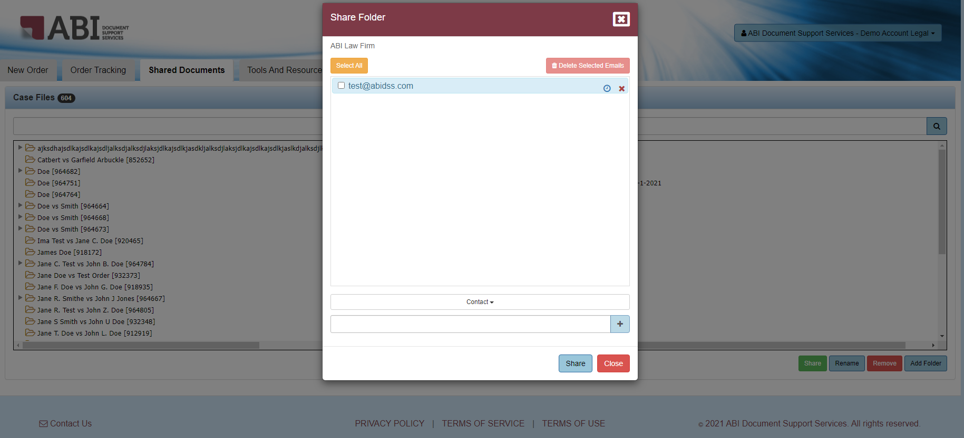

Shared Documents User Guide
HOW TO SHARE DOCUMENTS
From here, you can utilize the Contact drop-down to select an email from the saved email address(es) added to your account.
If the email is not listed, enter the email address(es) of the parties with whom the documents should be shared, then click the ‘+’ button after each entry

Slide 9
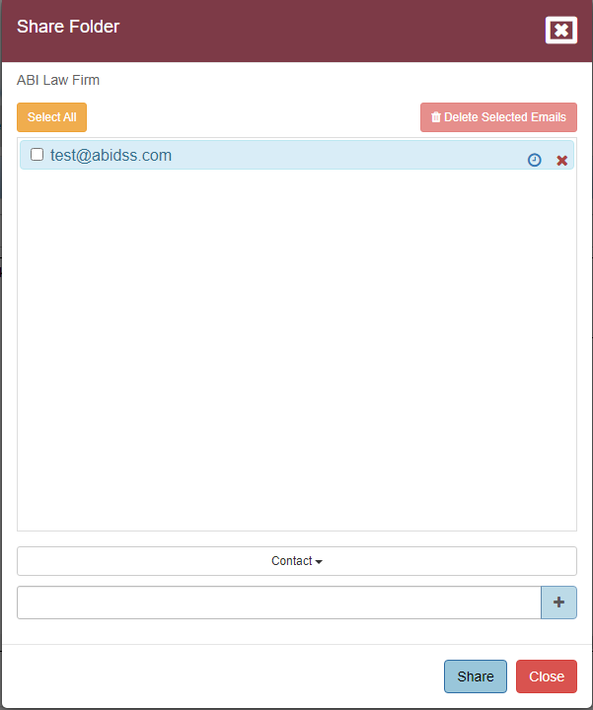
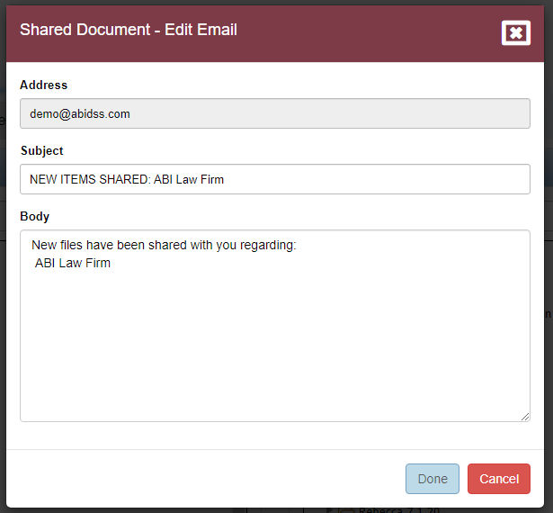
Shared Documents User Guide
HOW TO SHARE DOCUMENTS
After all email addresses have been added, click Email Template to make any changes to the Subject or Body of the emails being sent. Once done, select Share to share the documents

Slide 10
Shared Documents User Guide
RECIPIENT OF SHARED DOCUMENTS
Note: Accessing documents that have been shared requires the recipient to first create an eSummary Mobile account
To create an account, the recipient should click the “create a new password now” link from the shared records notification email. Once their password has been created, they can access the records at www.eSummaryMobile.com

Slide 11

SECURITY & ENCRYPTION
All eSummary Mobile data transmission from your account is encrypted over HTTPS
To protect eSummary Mobile’s data, ABI has instituted a 15 minute automatic sign-off for inactivity. After 14 minutes of inactivity, a warning message will alert users, providing them the opportunity to cancel the automatic platform sign-off

Slide 12
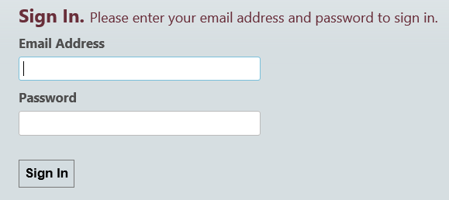
Shared Documents User Guide
ACCESSING DOCUMENTS USING
eSUMMARY MOBILE
To access documents that have been shared using eSummary Mobile, the recipient must access the documents through their own eSummaryMobile.com account
Using any web browser, simply login at www.eSummaryMobile.com
Enter the registered email address and password into the appropriate fields, then click Sign In

Slide 13
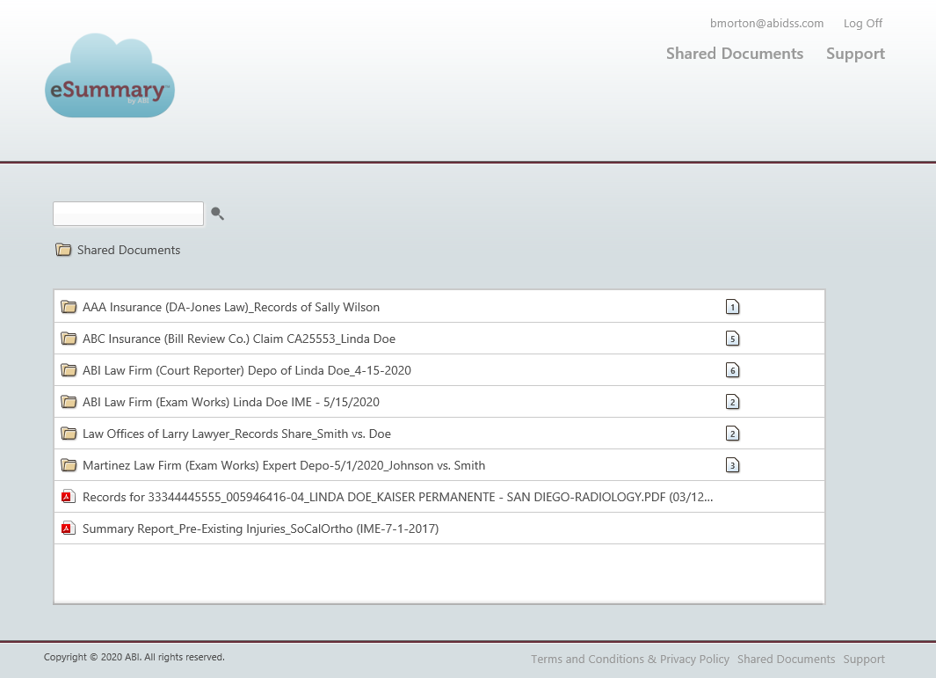
Shared Documents User Guide
ACCESSING DOCUMENTS USING
eSUMMARY MOBILE
Upon login, the screen displays all shared folders and documents

Slide 14
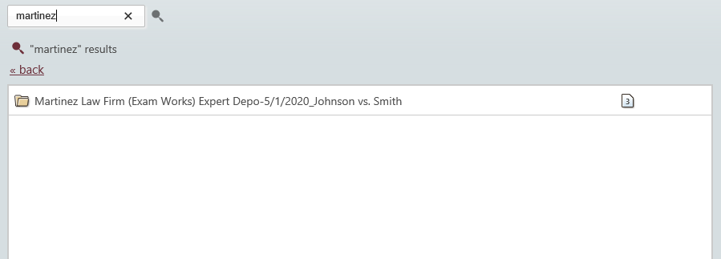
Shared Documents User Guide
SEARCHING FOR DOCUMENTS
To locate a specific folder or document name, type your search term(s) into the blank box, then click enter on the keyboard or select the search icon
The paper icon in the right margin will display the total number of documents contained within the folder
Note: To clear search results, select the back button

Slide 15
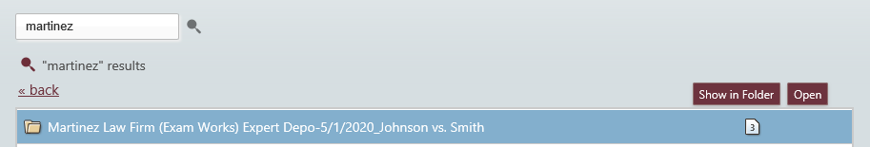
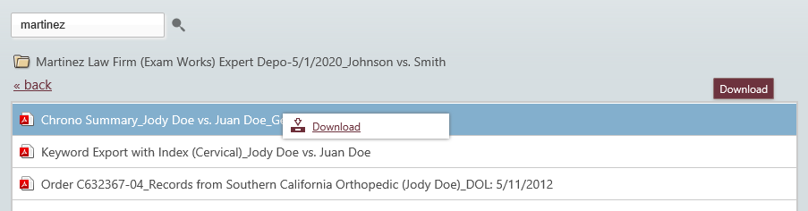
Shared Documents User Guide
DOWNLOADING DOCUMENTS
Click on the folder name, then select Open to reveal the contents or simply double-click on the folder name
Click on the document name, displaying the Download button, or right-click, which will open a pop-up box. Either method will allow the user to download the selected document
Select Open, Save or Cancel during the download process, when the dialogue box populates at the bottom of your screen

Slide 16
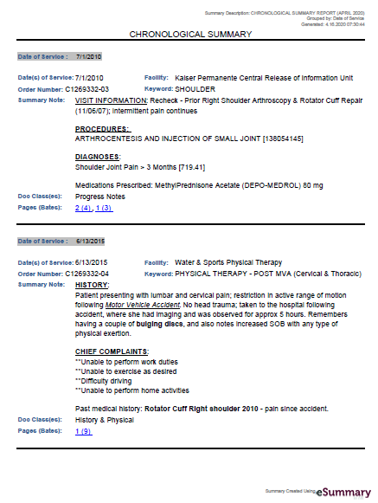
Shared Documents User Guide
VIEWING DOCUMENTS
Documents will open in either a Word, Excel or PDF program, depending upon which type of document was shared
Note: Documents can be removed from the recipient’s eSummary Mobile account by the sender at any time. Recipients should download the documents to their desktop or case management system prior to viewing, in order to ensure continuous access

Slide 17

Powerful Solutions, Effective Results

