Slide 1
Lexis Red® Briefing
App version 3.18 – released 25 July 2022

Slide 2
Important updates in Lexis Red 3.18
Overview
Ability to drag and drop titles on publications page
Footnotes and endnotes automatically appended to downloaded documents
Cleaner image of publication covers in delivered documents
Updated message on empty publications screen

Slide 3
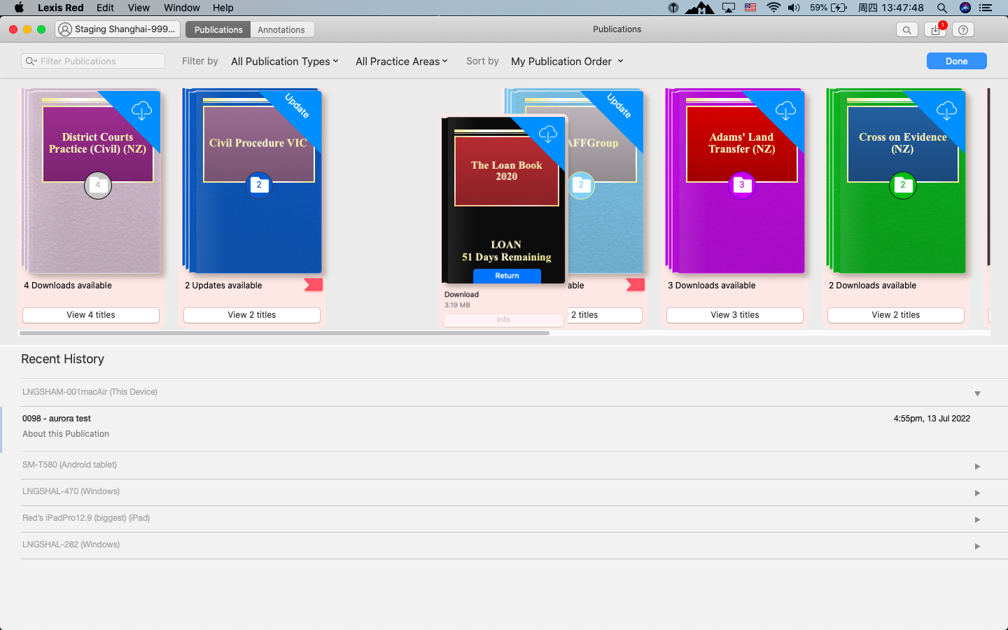
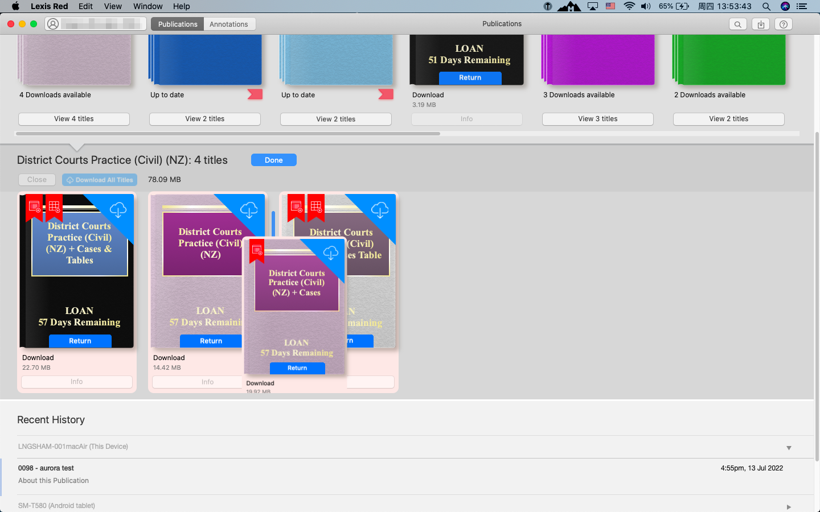
Drag and drop titles on publications page
Problem statement: Users wanted to be able to quickly customise the order of titles on the publication page.
Solution: Users can now drag and drop titles to re-order the publication page according to their preferences.
Drag and drop titles/ groups of titles on publication page
Drag and drop titles within group
Mac image 3.18
Mac image 3.18

Slide 4
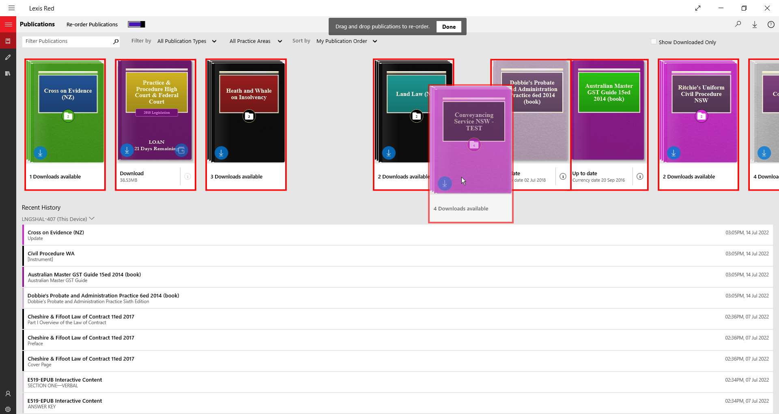
Drag and drop titles on publications page — Windows
Windows
Select ‘My Publication Order’ from ‘Sort by’ menu.
Activate drag and drop by switching on ‘Re-order Publications’ toggle.
Drag a title to an empty spot and release.
Click ‘Done’ once finished re-ordering titles.
Windows image 3.18

Slide 5
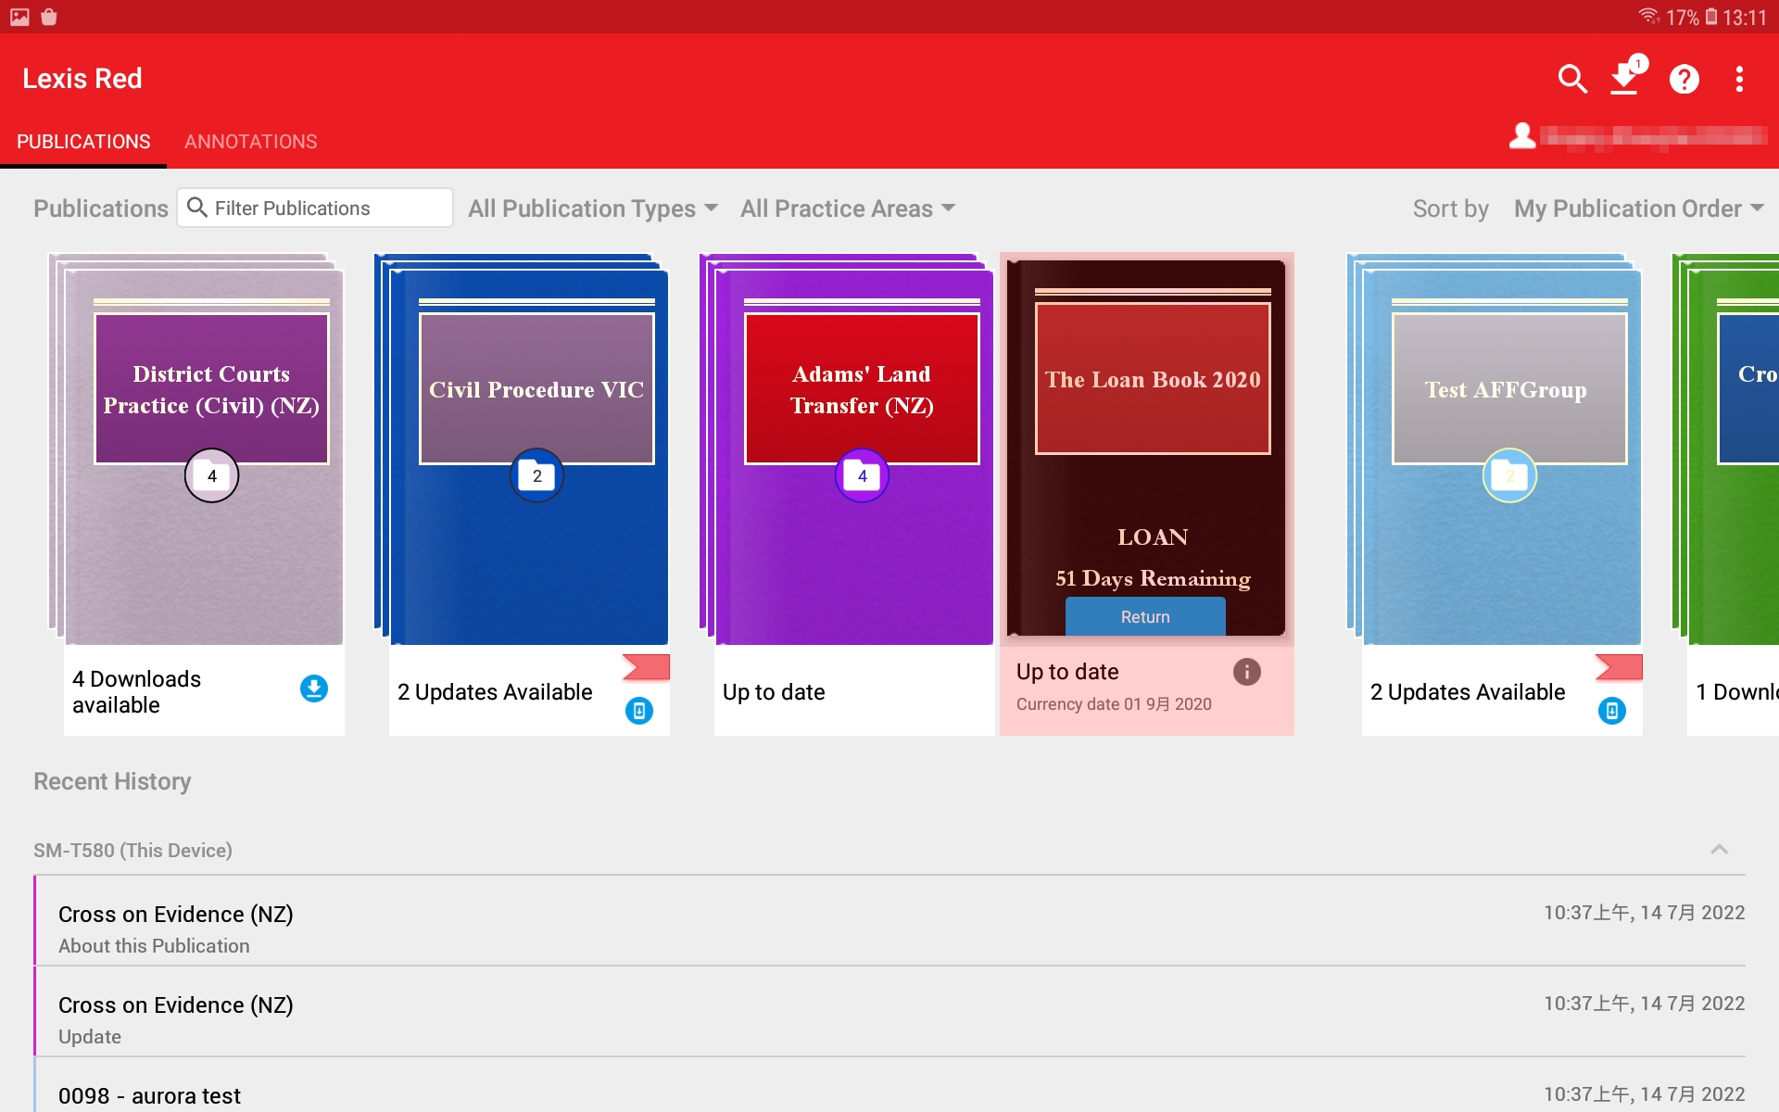
Drag and drop titles on publications page — Android
Android
Select ‘My Publication Order’ from ‘Sort by’ menu.
Activate drag and drop by long pressing on a title.
Drag title to an empty spot and release.
Android image 3.18

Slide 6
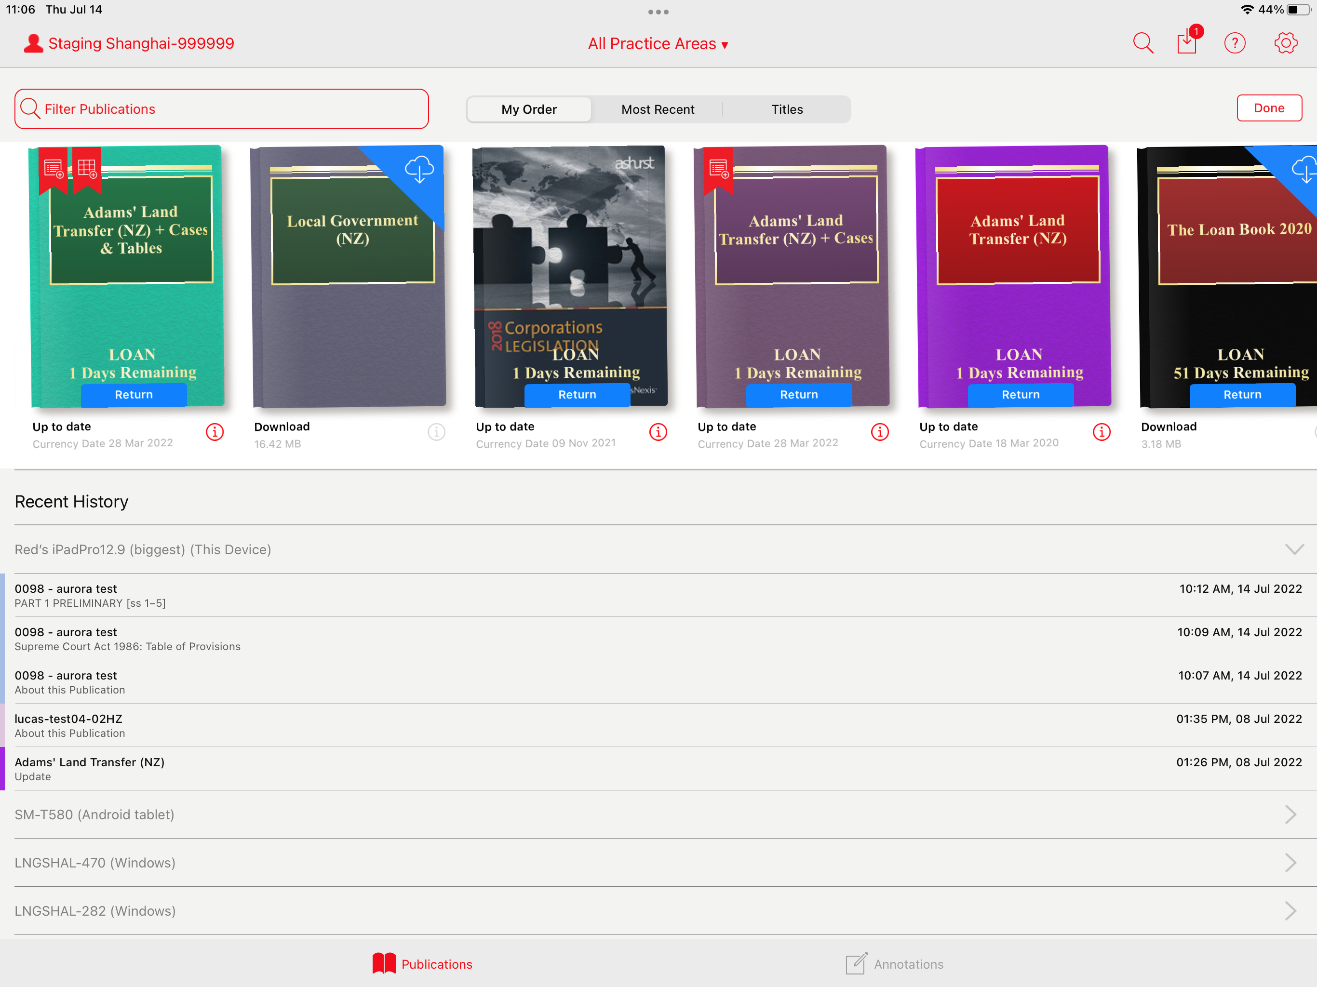
Drag and drop titles on publications page — iOS
iOS
Select ‘My Order’ from ‘Sort by’ menu.
Activate drag and drop by long pressing on a title.
Drag title to an empty spot and release.
Click ‘Done’ once finished re-ordering titles.
iOS image 3.18

Slide 7
Drag and drop titles on publications page — Mac
Mac
Select ‘My publication Order’ from ‘Sort by’ menu.
Activate drag and drop by long clicking on a title.
Drag title to an empty spot and release.
Click ‘Done’ once finished re-ordering titles.
Mac image 3.18

Slide 8
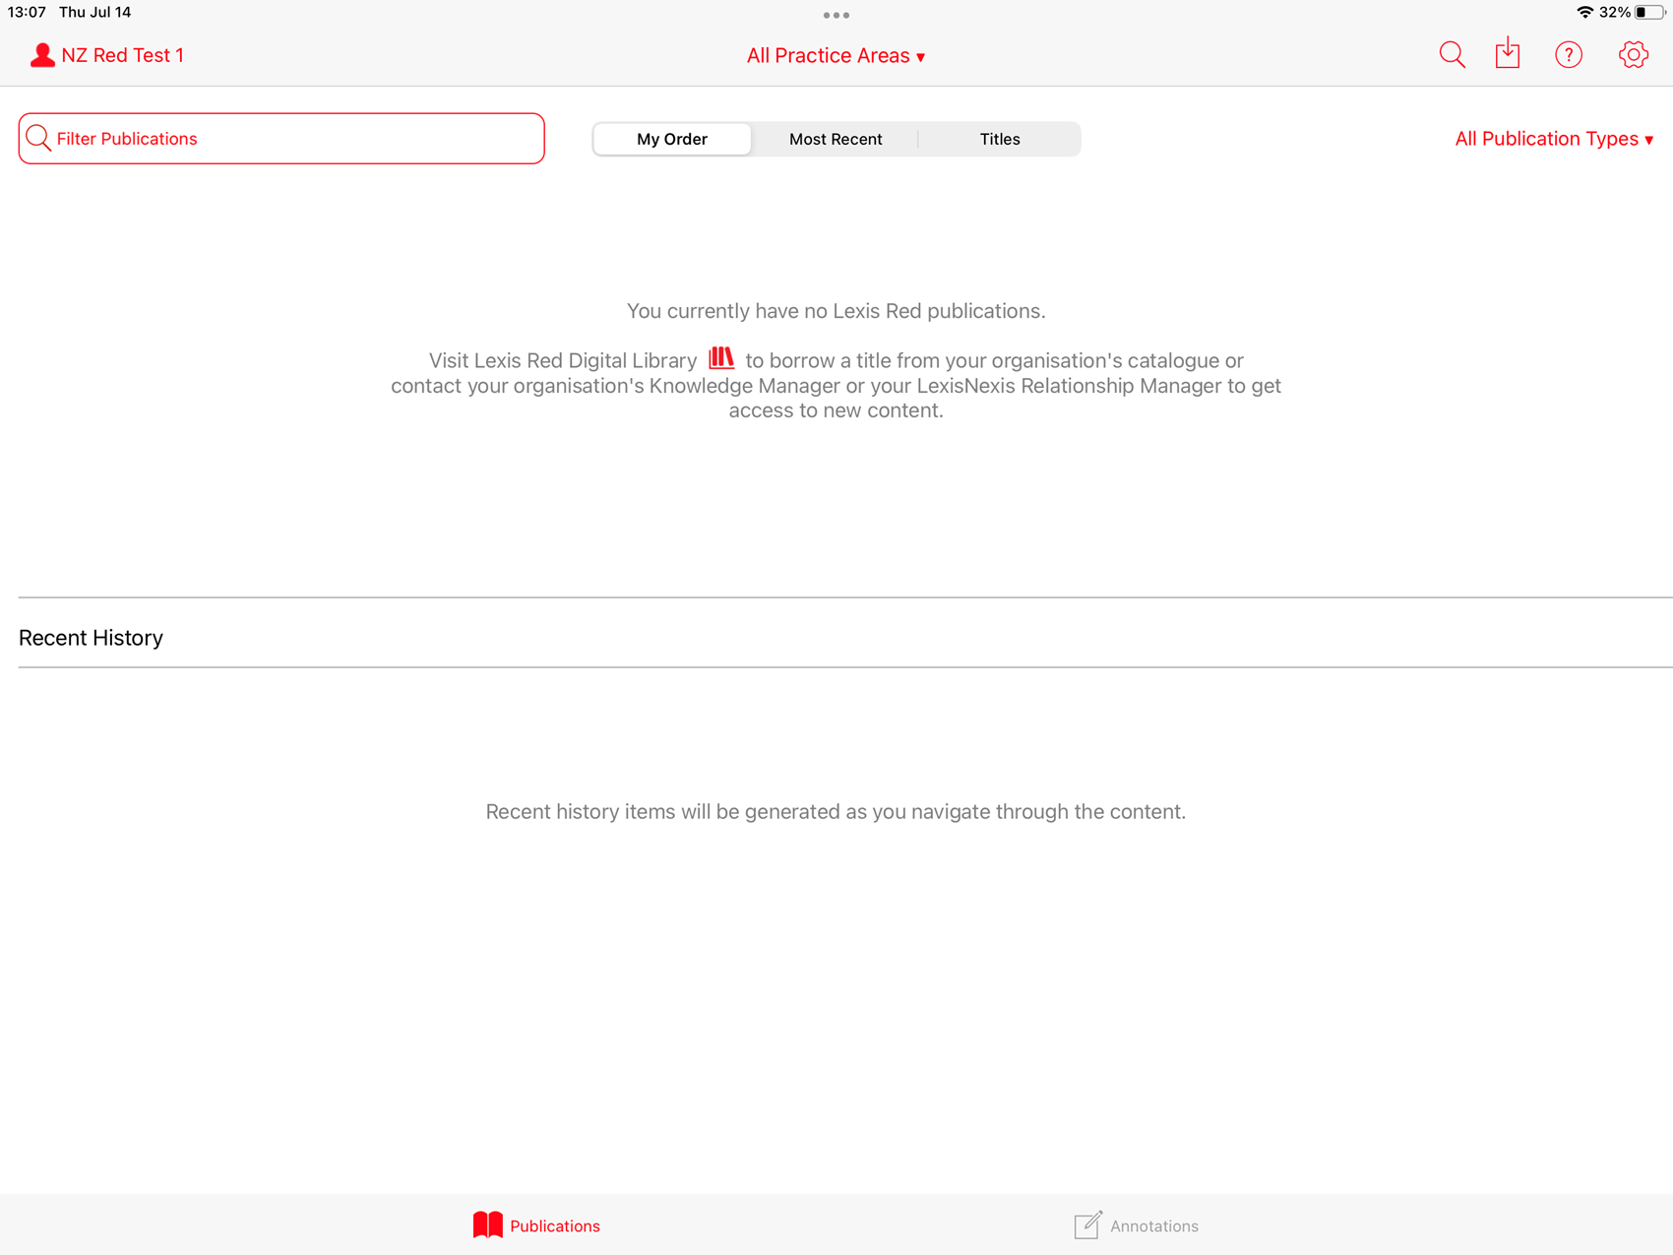
Updated message on empty publications screen
Problem statement: Users who have no titles on their account may not be aware they can borrow titles from their organisation’s catalogue via Digital Library.
Solution: The message on the empty publications screen has been updated with instructions for accessing Digital Library. The updated message will only appear for users who have Digital Library enabled on their account.
iOS image 3.18

Slide 9
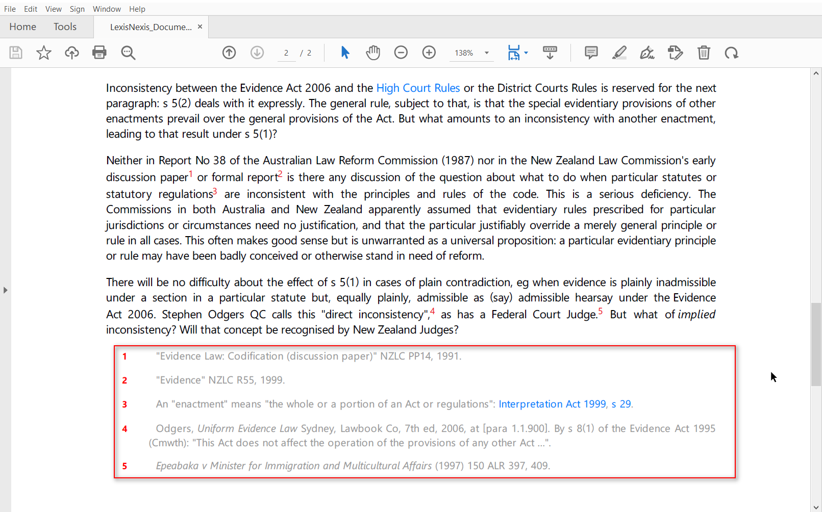
Footnotes and endnotes automatically appended to downloaded documents
Problem statement: When users download content as a PDF, they want to see footnotes and endnotes associated with the selected content.
Solution: When a user selects content and saves as a PDF, any footnotes or endnotes associated with the selected content will be automatically appended to the delivered document.
Windows image 3.18

Slide 10
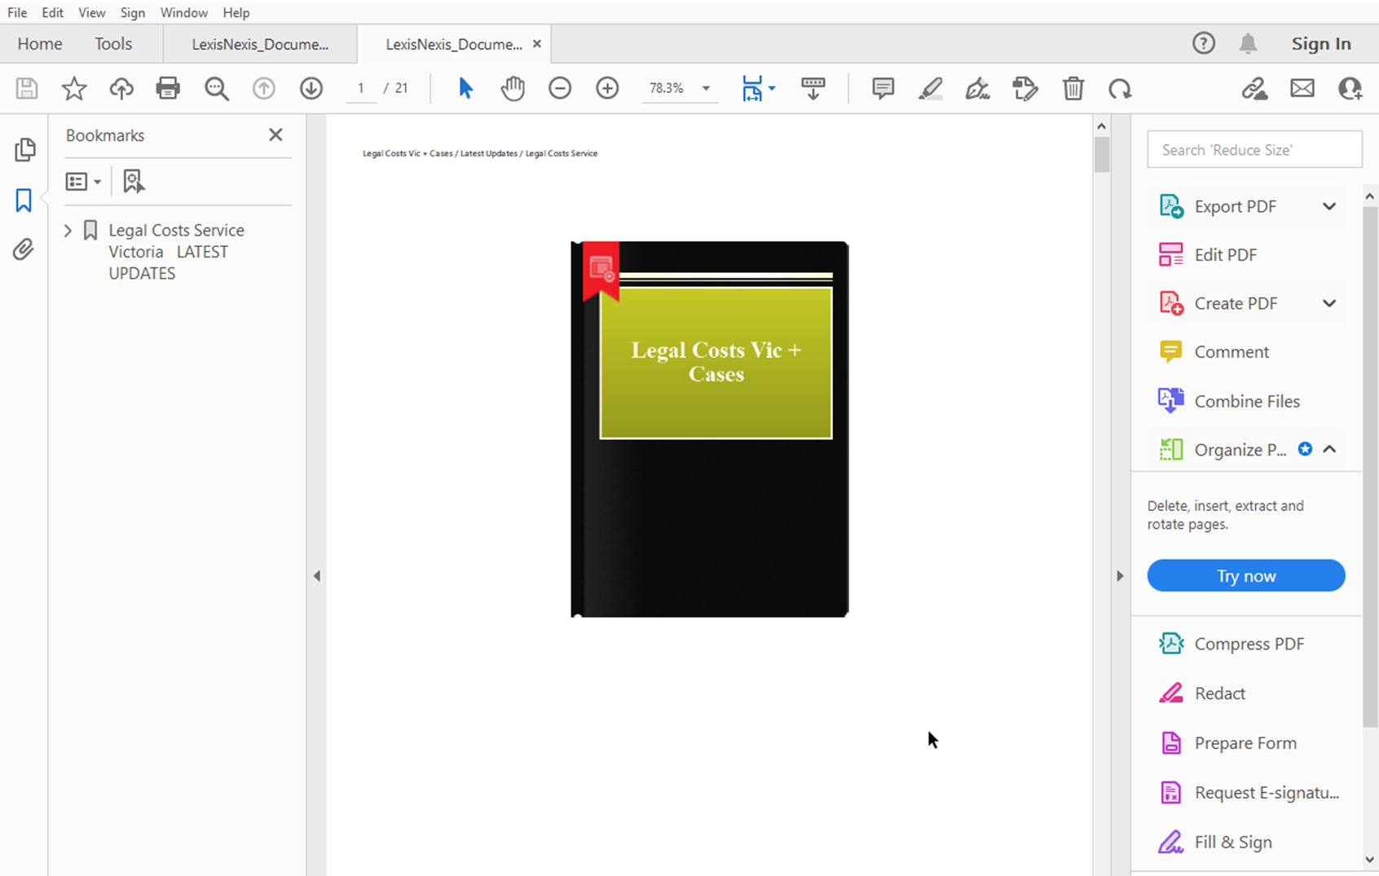
Cleaner image of publication covers in delivered documents
Problem statement: When downloading titles in PDF format, the publication cover is in low resolution and is partially obscured by loan information (in the case of loan titles).
Solution: When a user downloads a title as a PDF, the publication cover will now appear in high resolution and without any loan information.
Windows image 3.18

Slide 11
Lexis Red
Important Details
Lexis Red Microsite
See more information about Lexis Red for your business, app download links, user guides and FAQs.
URL: https://www.lexisnexis.com.au/en/products-and-services/lexis-red
Lexis Red Knowledge Network
Find links to a variety of free training videos, PDF guides and webinars designed to familiarise users and knowledge managers with the Lexis Red app and Digital Library.
URL: https://www.lexisnexis.com.au/en/knowledge-network/lexis-red
Customer Support
For further Lexis Red enquiries or concerns, contact Customer Support at customersupport@lexisnexis.com.au or 1800 772 772, or contact your Relationship Manager or Learning Consultant directly.

Slide 12
Thank you.

